Slide 1

BOTANICAL SURVEY OF INDIA ,
ANDAMAN & NICOBAR REGIONAL CENTRE
PORT BLAIR - 744 102
LAL JI SINGH

Slide 2
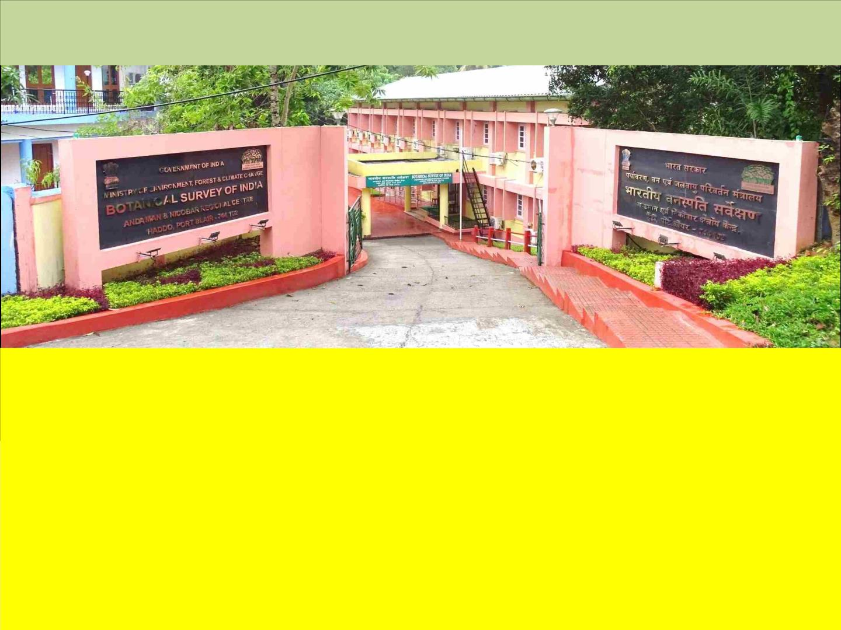
BOTANICAL SURVEY OF INDIA,
ANDAMAN AND NICOBAR REGIONAL CENTRE, PORT BLAIR
•
•
•
•
•
•
•
•
•
•
•
Established
Jurisdiction
:
:
30-03-1972
Andaman & Nicobar (ca 8249 sq. km.)
Herbarium Acronym :
PBL
Explorations
:
255 exploration tours
Accessioned Sheets
Type specimens
New Genera
:
40,000
:
418
:
:
05
New Species
ca 145
Publications
:
11 books & 1248 research articles
Library holdings
:
5123 books & Journals
Experimental Garden :
Dhanikhari Exp. Garden-cum- Arboretum (DEGCA)(30 Ha.) ca 600 spp.

Slide 3

Approved Annual Action Plan (April, 2022-March, 2023) – 02
Project 01:
Conservation Assessment, ENM studies including GIS mapping of Endemic trees of
Andaman & Nicobar Islands. (50 Endemic Species) (2021-2023)
Dr. Chandan Singh Purohit, Scientist-C
Dr. Lal Ji Singh, Scientist-E
Dr. Vivek C.P., Bot. Asstt. &
Shri Bishnu Charan Dey, Bot. Asstt.
WORK DONE & ACHIVEMENTS (2022 – 2023):
o 03 Field tour undertaken
o Conservation Assessment of 50 endemic tree species have
been documented based on EOO, AOO, field observation and
herbarium consultation.
o Besides, germplasm of 55 rare and threatened species were
collected and introduced in the Dhanikhari Experimental
Garden cum Arboretum.
o All targets have been achieved and final report submitted on
27.04.2023.

Slide 4
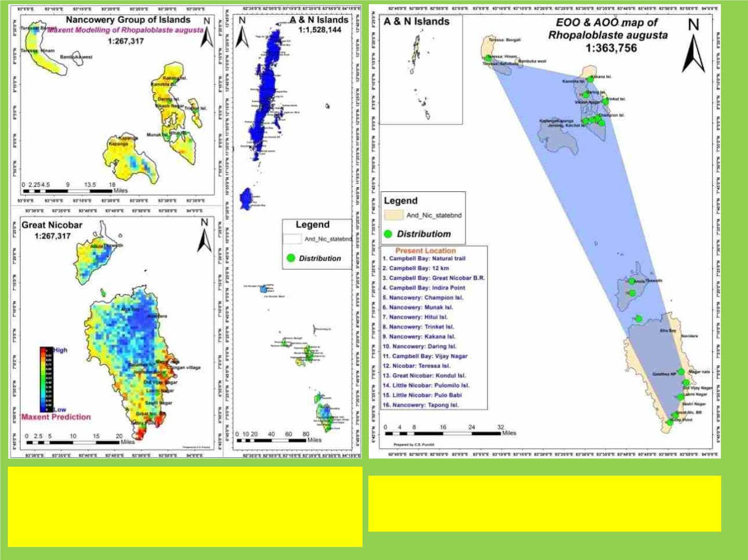
Map showing potential distribution and
Habitat suitability of Rhopaloblaste
augusta (Kurz) H. E. Moore
Map showing EOO & AOO of Rhopaloblaste
augusta (Kurz) H. E. Moore

Slide 5
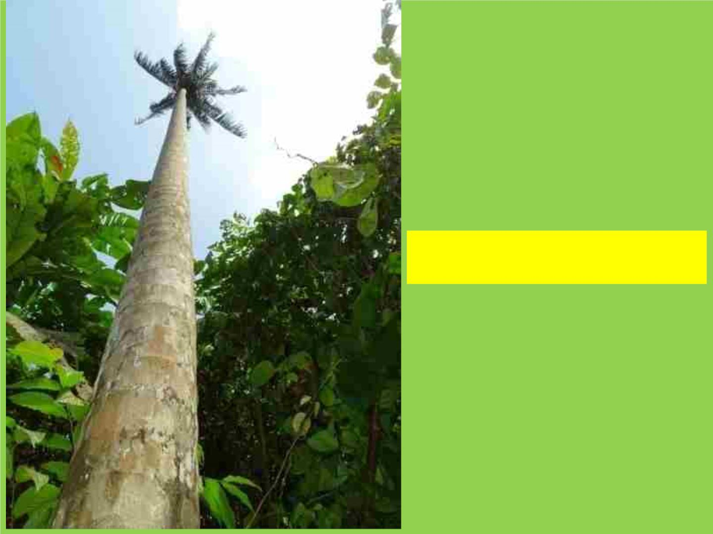
Rhopaloblaste augusta
(Kurz) H. E. Moore -in natural habitat

Slide 6

Bentinckia nicobarica (Kurz) Becc. -in natural habitat

Slide 7

Project No: 02
Curatorial work of Botanical Garden : (Multiplication and Nursery development
of Bamboos, Palms, Zingibers, Endemic trees species of Andaman & Nicobar
Islands at Dhanikhari Experimental Garden Cum Arboretum (2022-2024)
Shri Bishnu Charan Dey, Bot. Asstt.
Shri Basil Paul, Bot. Asstt. &
Shri Gautam Anuj Ekka, Bot. Asstt.
WORK DONE & ACHIVEMENTS (2022 – 2023):
o 03 field tours undertaken
o Germplasm of 41 species were collected and introduced in the
Dhanikhari Experimental Garden cum Arboretum.
o Raised nursery for multiplication.
o Monitoring of previous collections.
PUBLICATIONS by ANRC (2022-2023):
Research Paper: 25
Popular Article: 03

Slide 8
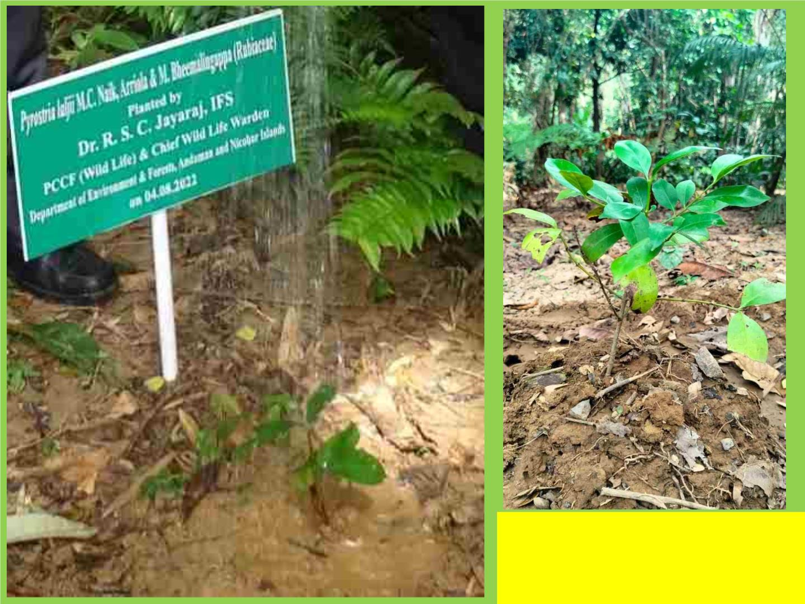
Pyrostria laljii M.C. Naik, Arriola &
Bheem. under ex-situ conservation
at DEGCA

Slide 9
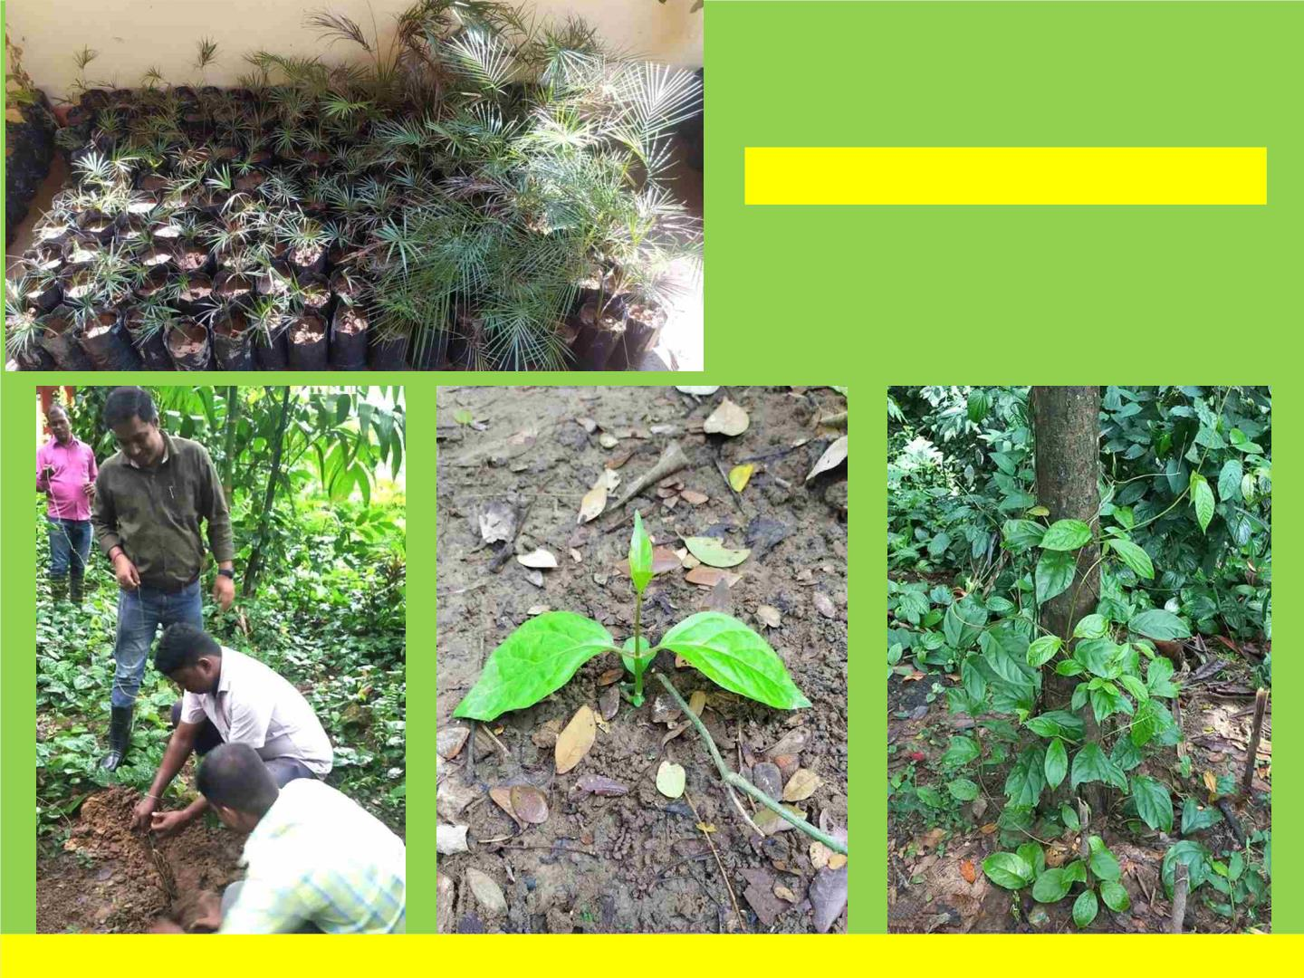
Raised nursery for multiplication
Ceropegia andamanica Sreek., Veenakumari & Prashanth under ex-situ conservation at DEGCA

Slide 10

New project as per AAP 2023-24: 05
1. Macrofungi of Andaman & Nicobar Islands (Dr. Mahadevakumar,
S., Scientist C)
2. Ethnobotanical Study of Ranchi communities / settlers of
Andaman Islands (Dr. Pankaj A. Dhole, Botanist, Mr. Gautam Anuj
Ekka, Botanical Assistant and Dr. Lal Ji Singh, Scientist-E).
3. Flora of Cinque Wildlife Sanctuary, South Andaman (Dr. Anil
Kumar Midigesi, Botanist, Shri Gautam Anuj Ekka, Botanical
Assistant and Dr. Lal Ji Singh, Scientist-E)
4. A pictorial guide to Flora of Mount Manipur National Park, South
Andaman (Dr. Pankaj A. Dhole, Botanist, Mr. Gautam Anuj Ekka ,
Botanical Assistant and Dr. Lal Ji Singh, Scientist-E).
5. A pictorial guide to Flora of Shaheed Dweep (Neil Island), South
Andaman (Dr. Pankaj A. Dhole, Botanist and Dr. Lal Ji Singh,
Scientist-E)

Slide 11

Manuscripts submitted as per AAP 2022-23: 01
Conservation Assessment, ENM studies including GIS mapping of 50 Endemic trees of
Andaman & Nicobar Islands (2021-2023) on 27.04.2023.

Slide 12

Details of augmentation of herbarium holdings (with list of
specimens identified, mounted, accessioned and incorporated
during the year)
Total field numbers vouched: 130 field numbers
Identified and incorporated in PBL: 130
Name of species
Family
SCROPHULARIACEAE
MYRISTICACEAE
Lindernia antipoda (L.) Alston
Knema andamanica (Warb.) W.J. de Wilde subsp.
nicobarica (Warb.) W.J. de Wilde
Argyreia spp.
CONVOLVULACEAE
FABACEAE
Bauhinia spp.
Caesalpinia cucullata Roxb.
Glochidion calocarpum Kurz
Spathoglottis plicata Blume
Imperata cylindrica (L.) Raeusch.
Leea grandifolia Kurz
CAESALPINIACEAE
EUPHORBIACEAE
ORCHIDACEAE
POACEAE
LEEACEAE
Radermachera pinnata (Blanco) Seem.
BIGNONIACEAE

Slide 13

Setaria spp.
POACEAE
Ischaemum muticum L.
POACEAE
Ficus variegata Blume
MORACEAE
Mangifera nicobarica Kosterm.
Grewia calophylla Kurz ex Mast.
Dillenia andamanica C.E. Parkinson
Maesa ramentacea (Roxb.) A. DC
Clerodendrum chinense (Osbeck) Mabb.
Ficus sinuata Thunb.
ANACARDIACEAE
TILIACEAE
DILLENIACEAE
MYRSINACEAE
VERBENACEAE
MORACEAE
Melastoma malabathricum L.
Piper nigrum L.
MELASTOMATACEAE
PIPERACEAE
RUBIACEAE
Uncaria cordata (Lour.) Merr.
Ficus spp.
MORACEAE
Alpinia zerumbet (Pers.) B.L.Burtt & R.M.Sm.
Thuarea involuta (G. Forst.) R. Br. ex Sm.
Ardisia andamanica Kurz
ZINGIBERACEAE
POACEAE
MYRSINACEAE
FABACEAE
Tephrosiapurpurea (L.) Pers.
Argyreia spp.
CONVOLVULACEAE
ARECACEAE
Rhopaloblaste angustata (Kurz) Moore
Gnetum montanum Markgr.
Rubus moluccanus L.
GNETACEAE
ROSACEAE
Clerodendrum infortunatum L.
Plagiostachys nicobarica M. Sabu & al.
Mitragyna rotundifolia (Roxb.) Kuntze
Leea grandifolia Kurz
VERBENACEAE
ZINGIBERACEAE
RUBIACEAE
LEEACEAE

Slide 14

Rubus moluccanus L.
ROSACEAE
Solanum lasiocarpum Dunal
SOLANACEAE
RUBIACEAE
Ixora spp.
Mussaenda villosa Wall. ex Hook.f.
Plagiostachys nicobarica M. Sabu & al.
Leea grandifolia Kurz
RUBIACEAE
ZINGIBERACEAE
LEEACEAE
Tournefortiaargentea L.f.
BORAGINACEAE
ZINGIBERACEAE
CONVOLVULACEAE
APOCYNACEAE
Alpinia purpurata (Vieill.) K.Schum.
Merremia tuberosa (L.) Rendle
Alstonia parkinsonii (M. Gangop. & Chakrab.) Lakra & Chakrab.
Rottboellia cochinchinensis (Lour.) Clayton
Dendrobium crumenatum Sw.
Macaranga nicobarica N.P. Balakr. & Chakr.
Jasminum elongatum (P.J. Bergius) Willd.
Passiflora spp.
POACEAE
ORCHIDACEAE
EUPHORBIACEAE
OLEACEAE
PASSIFLORACEAE
CONVOLVULACEAE
PASSIFLORACEAE
FABACEAE
Merremia vitifolia (Burm.f.) Hallier f.
Passiflora foetida L.
Crotalaria spp.
Alstonia macrophylla Wall. ex G. Don
Glochidion spp.
APOCYNACEAE
EUPHORBIACEAE
MALVACEAE
Pavonia spp.
Gardenia tubifera Wall. ex Roxb.
Ipomoea spp.
RUBIACEAE
CONVOLVULACEAE
EUPHORBIACEAE
EUPHORBIACEAE
Glochidion zeylanicum (Gaertn.) A. Juss.
Bridelia spp.

Slide 15

Argyreia spp.
CONVOLVULACEAE
CONVOLVULACEAE
MALVACEAE
Merremia umbellata (L.) Hallier f.
Abelmoschus esculentus (L.) Moench.
Ficus spp.
MORACEAE
Ficus spp.
MORACEAE
Heteropogon contortus (L.) P. Beauv. ex Roem.& Schult.
POACEAE
Alysicarpus spp.
FABACEAE
Sonneratia alba Sm.
SONNERATIACEAE
AIZOACEAE
Sesuvium portulacastrum (L.) L.
Passiflora spp.
PASSIFLORACEAE
MIMOSACEAE
EUPHORBIACEAE
COMBRETACEAE
CONVOLVULACEAE
FABACEAE
Archidendron clypearia (Jack) I.C. Nielsen
Euphorbia serpens Kunth
Terminalia citriana (Gaertn.) Roxb.
Operculina turpethum (L.) Silva Manso
Uraria lagopodioides (L.) DC.
Passiflora foetida L.
PASSIFLORACEAE
FABACEAE
Uraria picta (Jacq.) Desv. ex DC.
Cissampelos pareira L. var. hirsuta (Buch.-Ham.Ex DC.) Forman
MENISPERMACEAE
Ipomoea obscura (L.) Ker Gawl.
CONVOLVULACEAE
PLUMBAGINACEAE
SCROPHULARIACEAE
MELASTOMATACEAE
CLUSIACEAE
Plumbago zeylanica L.
Lindernia antipoda (L.) Alston
Otanthera nicobarensis Teijsm. & Binn.
Garcinia andamanica King
Knema andamanica (Warb.) W.J. de Wilde subsp. nicobarica (Warb.) W.J. de Wilde
MYRISTICACEAE
Caesalpinia cucullata Roxb.
CAESALPINIACEAE
SAPOTACEAE
Manilkara littoralis (Kurz) Dubbard
Adhatoda vasica Nees
ACANTHACEAE
ANNONACEAE
Goniothalamus macranthus (Kurz) Boerl.

Slide 16

Diospyros spp.
EBENACEAE
Barringtonia spp.
BARRINGTONIACEAE
EUPHORBIACEAE
ANNONACEAE
LAMIACEAE
Glochidion sp.
Orophea katschallica Kurz
Pogostemon sp.
Strobilanthes andamanensis Bor
Pogonatherum crinitum (Thunb.) Kunth
Garcinia andamanica King
Alstonia sp.
ACANTHACEAE
POACEAE
CLUSIACEAE
APOCYNACEAE
AMARANTHACEAE
MYRISTICACEAE
DILLENIACEAE
SAPOTACEAE
CLUSIACEAE
Cyathula prostrata (L.) Blume
Knema andamanica (Warb.) W.J. de Wilde
Dillenia andamanica C.E. Parkinson
Mimusops andamanensis King & Gamble
Mesua manii (King) Kosterm.
Grewia calophylla Kurz ex Mast.
Garcinia andamanica King
Orophea katschallica Kurz
Canthium sp.
TILIACEAE
CLUSIACEAE
ANNONACEAE
RUBIACEAE
Aporosa sp.
EUPHORBIACEAE
LYTHRACEAE
Lagerstroemia hypoleuca Kurz
Myristica andamanica Hook.f.
Murdannia sp.
MYRISTICACEAE
COMMELINACEAE
ASCLEPIADACEAE
CONVOLVULACEAE
CONVOLVULACEAE
POACEAE
Tylophora sp.
Ipomoea obscura (L.) Ker Gawl.
Ipomoea triloba L.
Thuarea involuta (G. Forst.) R. Br. ex Sm.
Themeda arguens (L.) Hack.
Strobilanthes andamanensis Bor
Staurogyne andamanensis Bor
Ficus ribes Reinw. ex Blume
Strobilanthes andamanensis Bor
POACEAE
ACANTHACEAE
ACANTHACEAE
MORACEAE
ACANTHACEAE

Slide 17

Hygrophila auriculata (Schumach.) Heine
Diospyros discolor Willd.
ACANTHACEAE
EBENACEAE
Grewia calophylla Kurz ex Mast.
Psychotria andamanica Kurz
TILIACEAE
RUBIACEAE
Arthraxon hispidus (Thunb.) Makino
Ipomoea maxima (L.f.) G. Don ex Sweet
Limnophila chinensis (Osbeck) Merr.
Murdannia sanjappae MC. Naik et B.R.P. Rao
Tylophora indica (Burm.f.) Merr.
Smilax odoratissima Blume
POACEAE
CONVOLVULACEAE
SCROPHULARIACEAE
COMMELINACEAE
ASCLEPIADACEAE
SMILACACEAE
CONVOLVULACEAE
Jacquemontia pentantha (Jacq.) G. Don

Slide 18
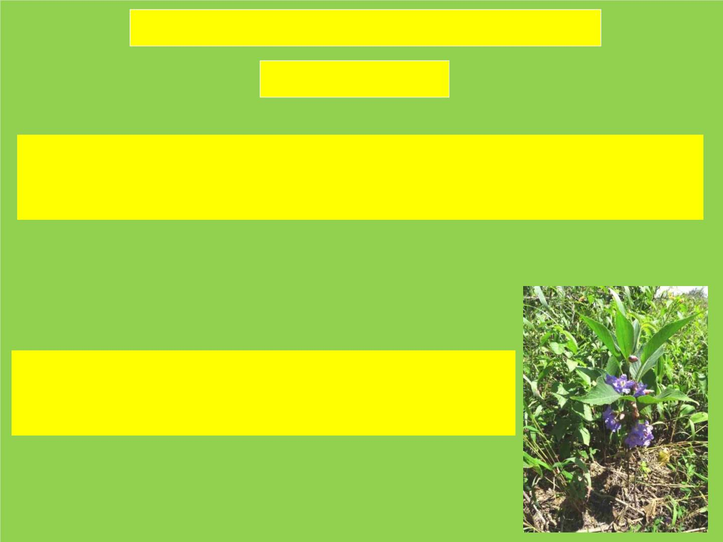
Interesting findings during the year 2022-23
Rediscovery: 02
Tephrosia pentaphylla (Roxb.) G. Don. (FABACEAE). Recollected after 126
years from Jhamuda, Raoli range in Todgarh-Raoli wildlife sanctuary, Rajasthan. -
Indian Journal of Arid Horticuluture 2(1-2): 79 – 80.
Strobilanthes halbergii Blatt. (ACANTHACEAE).
Rediscover again after a lapse of 101 year from Mount Abu
wildlife sanctuary, Rajasthan.- Phytotaxonomy, 22 – 27

Slide 19
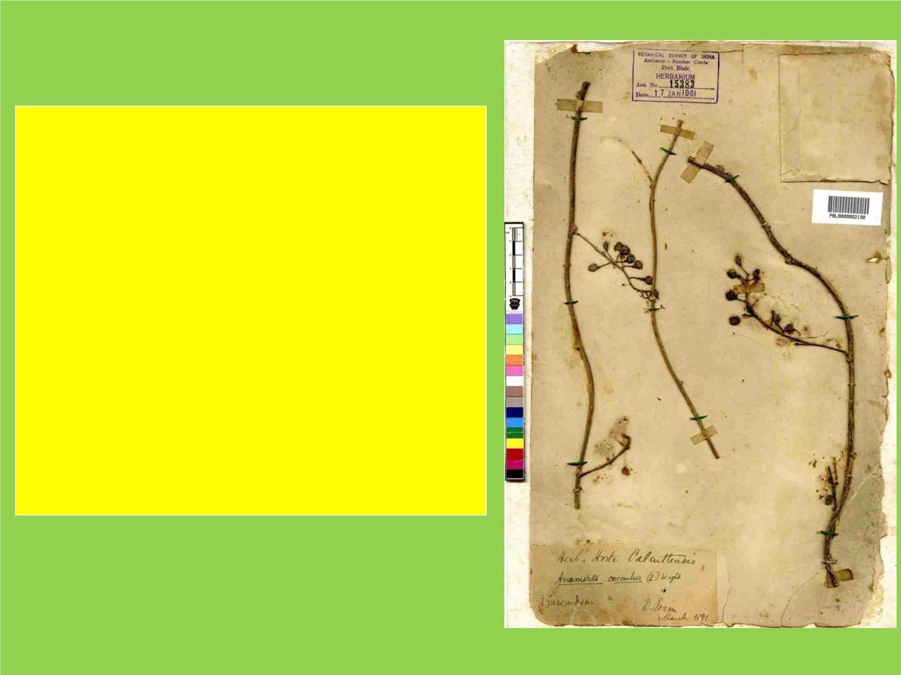
No. of herbarium sheets digitized
and details of metadata prepared
during the year 2022-23 : 9819
Total number of digitized sheets:
24352
Remarks: PBL contributed more than
25000 specimens including types
(418) to India’s Virtual Herbarium.

Slide 20

Garden activities (2022-23)
a. Status of EET species (with numbers and Names) growing in the
Botanical garden. 40 nos. (list of plants submitted through mail)
Germplasm of following species have been collected and introduced as a part of
conservation.
Name
No. of seedlings
20 nos.
10 nos.
Aglaia andamanica Hiern
Amomum andamanicum V.P. Thomas & al.
Bentinckia nicobarica (Kurz) Becc.
Boesenbergia siphonantha (King ex Baker) M. Sabu
Bombax insigne Wall.
300 nos.
40 nos.
20 nos.
Bouea oppositifolia (Roxb.) Adelb.
Calamus andamanicus Kurz
05 nos.
10 nos.
07 nos.
01 no.
19 nos.
18 nos.
29 nos.
03 nos.
15 nos.
69 nos.
10 nos.
42 nos.
30 nos.
Carissa andamanensis L.J. Singh & Murugan
Ceropegia andamanica Sreek. & al.
Cycas zeylanica (J.Schust.) A.Lindstr. & K.D. Hill
Dillenia andamanica C.E. Parkinson
Diospyros marmorata R. Parker
Eria andamanica Hook.f.
Etlingera fenzlii (Kurz.) Skornick & M. Sabu
Garcinia andamanica King
Garcinia dhanikharensis S.K. Srivast.
Goniothalamus macranthus (Kurz) Boerl.
Grewia calophylla Kurz ex Mast.

Slide 21

Knema andamanica (Warb.) W.J. de Wilde
Mangifera andamanica King
Mangifera nicobarica Kosterm.
Mecaranga nicobarica N.P. Balakr. & Chakr.
Mesua manii (King) Kosterm.
Mimusops andamanensis King & Gamble
Musa acuminata Colla
Myristica andamanica Hook.f.
52 nos.
50 nos.
04 nos.
02 nos.
176 nos.
169 nos.
01 no.
155 nos.
08 nos.
10 nos.
04 nos.
50 nos.
53 nos.
05 nos.
10 nos.
03 nos.
248 nos.
16 nos.
10 nos.
05 nos.
15 nos.
10 nos.
Nervilia aragoana Gaudich.
Otanthera nicobarensis Teijsm. & Binn.
Phoenix andamanensis S. Barrow
Pinanga andamanensis Becc.
Pinanga manii Becc.
Plagiostachys nicobarica M. Sabu et al.
Pogonatherum crinitum (Thunb.) Kunth
Pyrostria laljii M.C. Naik, Arriola & M. Bheemalingappa
Rhopaloblaste angustata (Kurz) Moore
Schizostachyum andamanicum M. Kumar & Remesh
Semecarpus kurzii Engl.
Sphaeropteris albosetacea (Bedd.) R.M. Tryon
Strobilanthes andamanensis Bor
Vanilla sanjappae Rasingam, R.P. Pandey & al.

Slide 22

Name and no. of species introduced during 2022-23 both through ex-situ conservation or
micro propagation. (list of plants submitted through mail)
EET species : 40
Seedlings
Name
No. of seedlings
20 nos.
300 nos.
40 nos.
05 nos.
10 nos.
07 nos.
01 no.
Aglaia andamanica Hiern
Bentinckia nicobarica (Kurz) Becc.
Boesenbergia siphonantha (King ex Baker) M. Sabu
Bouea oppositifolia (Roxb.) Adelb.
Calamus andamanicus Kurz
Carissa andamanensis L.J. Singh & Murugan
Ceropegia andamanica Sreek. & al.
Cycas zeylanica (J.Schust.) A.Lindstr. & K.D. Hill
Dillenia andamanica C.E. Parkinson
Diospyros marmorata R. Parker
19 nos.
18 nos.
29 nos.
03 nos.
69 nos.
10 nos.
42 nos.
30 nos.
52 nos.
50 nos.
04 nos.
176 nos.
169 nos.
155 nos.
10 nos.
04 nos.
50 nos.
53 nos.
10 nos.
03 nos.
248 nos.
16 nos.
10 nos.
15 nos.
Eria andamanica Hook.f.
Garcinia andamanica King
Garcinia dhanikharensis S.K. Srivast.
Goniothalamus macranthus (Kurz) Boerl.
Grewia calophylla Kurz ex Mast.
Knema andamanica (Warb.) W.J. de Wilde
Mangifera andamanica King
Mangifera nicobarica Kosterm.
Mesua manii (King) Kosterm.
Mimusops andamanensis King & Gamble
Myristica andamanica Hook.f.
Otanthera nicobarensis Teijsm. & Binn.
Phoenix andamanensis S. Barrow
Pinanga andamanensis Becc.
Pinanga manii Becc.
Pogonatherum crinitum (Thunb.) Kunth
Pyrostria laljii M.C. Naik, Arriola & M. Bheemalingappa
Rhopaloblaste angustata (Kurz) Moore
Schizostachyum andamanicum M. Kumar & Remesh
Semecarpus kurzii Engl.
Strobilanthes andamanensis Bor

Slide 23

Seeds:
Name
No. of seeds
10 nos.
20 nos.
Bentinckia nicobarica (Kurz) Becc.
Bombax insigne Wall.
Myristica andamanica Hook.f.
Rhopaloblaste angustata (Kurz) Moore
Semecarpus kurzii Engl.
67 nos.
10 nos.
100 nos.
Cuttings:
Name
Dillenia andamanica C.E. Parkinson
Vanilla sanjappae Rasingam, R.P. Pandey & al.
No. of cuttings
01 no
10 nos.
Rhizome
Name
Amomum andamanicum V.P. Thomas & al.
Etlingera fenzlii (Kurz.) Skornick & M. Sabu
Etlingera sp.
Nervilia aragoana Gaudich.
Plagiostachys nicobarica M. Sabu et al.
No. of rhizome
10 nos.
15 nos.
04 nos.
08 nos.
05 nos.
Fruits
Name
No. of fruits
25 nos.
16 nos.
Alstonia spp.
Garcinia andamanica King
Goniothalamus macranthus (Kurz) Boerl.
Grewia calophylla Kurz ex Mast.
Myristica andamanica Hook.f.
31 nos.
31 nos.
08 nos.
Plantlets:
Name
Mecaranga nicobarica N.P. Balakr. & Chakr.
Musa acuminata Colla
No. of plantlets
02 nos.
01 no.
Sphaeropteris albosetacea (Bedd.) R.M. Tryon
05 nos.

Slide 24

ECONOMIC/ MEDICINAL: 35
Seedlings:
Name
No. of seedlings
05 nos.
05 nos.
14 nos.
15 nos.
30 nos.
05 nos.
03 nos.
08 nos.
10 nos.
15 nos.
27 nos.
01 no.
Alpinia sp.
Amomum sp.
Bauhinia sp.
Calotropis gigantea (L.) R.Br.
Curcuma roscoeana Wall.
Ficus benghalensis L.
Ficus religiosa L.
Garcinia sp.
Gigantochloa nigrociliata (Buse) Kurz
Mangifera indica L.
Mimusops sp.
Nyctanthes arbor-tristis L.
Pandanus amaryllifolius Roxb.
Pyrrosia piloselloides (L.) M.G. Price
Saccharum officinarum L.
Schizostachyum sp.
80 nos.
02 nos.
06 nos.
05 nos.
03 nos.
12 nos.
Zingiber spp.
Zingiber squarrosum Roxb.
Plantlets:
Name
No. of Plantlets
04 nos.
03 nos.
Bublophyllum sp.
Phalaenopsis spp.
Pogostemon spp.
Potamogeton nodosus Poir.
Pteroceras spp.
06 nos.
10 nos.
05 nos.
02 nos.
10 nos.
Rhynchostylis spp.
Typha angustifolia L.
Seeds:
Name
No. of seeds
37 nos.
50 nos.
Mimusops sp.
Ricinus communis L.
Sterculia spp.
50 nos.

Slide 25

Rhizome:
Name
No. of rhizome
04 nos.
02 nos.
Alpinia sp.
Curcuma amada Roxb.
Gloriosa superba L.
Zingiber spp.
20 nos.
01 no.
03 nos.
Zingiber squarrosum Roxb.
Cuttings:
Fruits:
Name
No. of cuttings
10 nos.
01 no.
Artocarpus chama Buch.-Ham.
Cerbera manghas L.
Lawsonia inermis L.
02 nos.
Name
No. of fruits
30 nos.
22 nos.
Alpinia nigra (Gaertn.) Burtt
Garcinia xanthochymus Hook.f. ex T. Anderson
Solanum lasiocarpum Dunal
15 nos.

Slide 26

ORNAMANTAL: 14
Seedlings:
Name
No. of seedlings
05 nos.
02 nos.
04 nos.
03 nos.
15 nos.
19 nos.
03 nos.
01 no.
Acanthus ilicifolius L.
Bulbophyllum rufinum Rchb.f.
Corypha utan Lam.
Monochoria vaginalis (Burm.f.) C. Presl
Nelumbo nucifera Gaertn.
Nervilia plicata (Andr.) Schltr.
Nymphaea nouchali Burm.f.
Nymphaea omrana
Nymphaea pubescens Willd.
Nymphoides indica (L.) Kuntze
01 no.
03 nos.
Plantlets:
Name
No. of plantlets
15 nos.
07 nos.
Caryota mitis Lour.
Corypha utan Lam.
Nymphoides indica (L.) Kuntze
Pistia stratiotes L.
06 nos.
15 nos.
Fruits:
Name
Name
No. of fruits
15 nos.
30 nos.
Corypha utan Lam.
Dacryodes sp.
Cuttings:
No. of cuttings
03 nos.
Lycopodium sp.

Slide 27

Mortality rate of the introduced species (Please mention no. and name of the species)
details submitted through mail.
Seedlings
EET species
No. of seedlings
Name
No. of Seedling survived
Mortality rate (in %)
Aglaia andamanica Hiern
Bentinckia nicobarica (Kurz) Becc.
20 nos.
300 nos.
10 nos.
250 nos.
50
17
Boesenbergia siphonantha (King ex Baker) M. Sabu
Bouea oppositifolia (Roxb.) Adelb.
40 nos.
05 nos.
30 nos.
02 nos.
25
66
Calamus andamanicus Kurz
Carissa andamanensis L.J. Singh & Murugan
10 nos.
07 nos.
08 nos.
05 nos.
20
29
Ceropegia andamanica Sreek. & al.
Cycas zeylanica (J.Schust.) A.Lindstr. & K.D. Hill
01 no.
19 nos.
01 no.
19 nos.
0
0
Dillenia andamanica C.E. Parkinson
18 nos.
15 nos.
16.7
Diospyros marmorata R. Parker
Eria andamanica Hook.f.
Garcinia andamanica King
Garcinia dhanikharensis S.K. Srivast.
Goniothalamus macranthus (Kurz) Boerl.
29 nos.
03 nos.
69 nos.
10 nos.
42 nos.
25 nos.
03 nos.
50 nos.
05 nos.
35 nos.
13.8
0
27.6
50
16.7
Grewia calophylla Kurz ex Mast.
Knema andamanica (Warb.) W.J. de Wilde
30 nos.
52 nos.
25 nos.
50 nos.
16.7
4
Mangifera andamanica King
50 nos.
04 nos.
176 nos.
169 nos.
50 nos.
02 nos.
100 nos.
150 nos.
0
50
43.2
11.3
Mangifera nicobarica Kosterm.
Mesua manii (King) Kosterm.
Mimusops andamanensis King & Gamble
Myristica andamanica Hook.f.
Otanthera nicobarensis Teijsm. & Binn.
155 nos.
10 nos.
110 nos.
05 nos.
29.1
50
Phoenix andamanensis S. Barrow
04 nos.
04 nos.
0
Pinanga andamanensis Becc.
Pinanga manii Becc.
Pogonatherum crinitum (Thunb.) Kunth
50 nos.
53 nos.
10 nos.
48 nos.
40 nos.
06 nos.
4
24.6
40
Pyrostria laljii M.C. Naik, Arriola & M.
Bheemalingappa
Rhopaloblaste angustata (Kurz) Moore
03 nos.
01 nos.
66.67
248 nos.
16 nos.
200 nos.
08 nos.
19.4
50
Schizostachyum andamanicum M. Kumar & Remesh
Semecarpus kurzii Engl.
Strobilanthes andamanensis Bor
10 nos.
15 nos.
05 nos.
05 nos.
50
66.67

Slide 28

Seeds:
Name
No. of seeds
10 nos.
20 nos.
67 nos.
10 nos.
100 nos.
No. of seeds survived
10 nos.
12 nos.
Mortality rate
Bentinckia nicobarica (Kurz) Becc.
Bombax insigne Wall.
Myristica andamanica Hook.f.
Rhopaloblaste angustata (Kurz) Moore
Semecarpus kurzii Engl.
0
40
37.4
0
42 nos.
10 nos.
80 nos.
20
Cuttings:
Name
Vanilla sanjappae Rasingam, R.P. Pandey & al.
No. of cuttings
10 nos.
No of cuttings survived
08 nos.
Mortality rate
20
Rhizome
Name
Amomum andamanicum V.P. Thomas & al.
Etlingera fenzlii (Kurz.) Skornick & M. Sabu
Etlingera sp.
Nervilia aragoana Gaudich.
Plagiostachys nicobarica M. Sabu et al.
No. of rhizome
10 nos.
15 nos.
No. of rhizome survived
10 nos.
15 nos.
Mortality rate
0
0
0
25
80
04 nos.
08 nos.
05 nos.
04 nos.
06 nos.
01 nos.
Fruits
Name
Alstonia spp.
Garcinia andamanica King
Goniothalamus macranthus (Kurz) Boerl.
Grewia calophylla Kurz ex Mast.
Myristica andamanica Hook.f.
No. of fruits
25 nos.
16 nos.
No. of fruits survived
15 nos.
09 nos.
Mortality rate
40
43.75
44.6
61.3
75
31 nos.
31 nos.
08 nos.
11 nos.
12 nos.
02 nos.
Plantlets:
Name
Macaranga nicobarica N.P. Balakr. & Chakr.
Musa acuminata Colla
No. of plantlets
02 nos.
01 no.
No. of plantlets survived
Mortality rate
01 nos.
01 nos.
04 nos.
50
0
20
Sphaeropteris albosetacea (Bedd.) R.M. Tryon
05 nos.

Slide 29

Seedlings:
ECONOMIC/ MEDICINAL
Name
No. of seedlings
05 nos.
05 nos.
14 nos.
15 nos.
30 nos.
05 nos.
03 nos.
08 nos.
10 nos.
15 nos.
27 nos.
01 no.
No. of seedlings survived
05 nos.
04 nos.
Mortality rate
Alpinia sp.
Amomum sp.
Bauhinia sp.
Calotropis gigantea (L.) R.Br.
Curcuma roscoeana Wall.
Ficus benghalensis L.
Ficus religiosa L.
Garcinia sp.
0
20
43
47
47
60
0
37.5
30
0
08 nos.
08 nos.
16 nos.
02 nos.
03 nos.
05 nos.
07 nos.
15 nos.
25 nos.
01 no.
75 nos.
01 no.
02 nos.
04 nos.
03 nos.
11 nos.
Gigantochloa nigrociliata (Buse) Kurz
Mangifera indica L.
Mimusops sp.
Nyctanthes arbor-tristis L.
Pandanus amaryllifolius Roxb.
Pyrrosia piloselloides (L.) M.G. Price
Saccharum officinarum L.
Schizostachyum sp.
7.5
0
80 nos.
02 nos.
06 nos.
05 nos.
03 nos.
12 nos.
6.3
50
66.67
20
0
Zingiber spp.
Zingiber squarrosum Roxb.
8.4
Rhizome:
Name
No. of rhizome
04 nos.
02 nos.
No. of rhizome survived
03 nos.
02 nos.
Mortality rate
Alpinia sp.
25
0
Curcuma amada Roxb.
Gloriosa superba L.
Zingiber spp.
20 nos.
01 no.
03 nos.
12 nos.
01 nos.
03 nos.
40
0
0
Zingiber squarrosum Roxb.
Cuttings:
Name
Artocarpus chama Buch.-Ham.
Cerbera manghas L.
No. of cuttings
10 nos.
01 no.
No. of cutting survived
03 nos.
01 no.
Mortality rate
70
00
50
Lawsonia inermis L.
02 nos.
01 nos.
Seeds:
Name
No. of seeds
37 nos.
50 nos.
No. of seeds survived
31 nos.
30 nos.
Mortality rate
Mimusops sp.
Ricinus communis L.
Sterculia spp.
12.3
40
50 nos.
28 nos.
44

Slide 30

Fruits:
Name
No. of fruits
30 nos.
22 nos.
No. of fruits survived
15 nos.
10 nos.
Mortality rate
Alpinia nigra (Gaertn.) Burtt
Garcinia xanthochymus Hook.f. ex T. Anderson
Solanum lasiocarpum Dunal
50
55
0
15 nos.
15 nos.
ORNAMANTAL
Seedlings:
Name
Acanthus ilicifolius L.
Bulbophyllum rufinum Rchb.f.
Corypha utan Lam.
Monochoria vaginalis (Burm.f.) C. Presl
Nelumbo nucifera Gaertn.
Nervilia plicata (Andr.) Schltr.
Nymphaea nouchali Burm.f.
Nymphaea omrana
No. of seedlings
05 nos.
02 nos.
04 nos.
03 nos.
15 nos.
19 nos.
03 nos.
01 no.
No. of seedlings survived
02 nos.
02 nos.
Mortality rate
60
0
75
0
7
26.4
0
01 nos.
03 nos.
14 nos.
14 nos.
03 nos.
01 nos.
0
Nymphaea pubescens Willd.
Nymphoides indica (L.) Kuntze
01 no.
03 nos.
01 nos.
03 nos.
0
0
Plantlets:
Name
Caryota mitis Lour.
Corypha utan Lam.
Nymphoides indica (L.) Kuntze
Pistia stratiotes L.
No. of plantlets
15 nos.
07 nos.
No. of plantlets survived
Mortality rate
10 nos.
01 nos.
06 nos.
15 nos.
33.4
86
0
06 nos.
15 nos.
0
Fruits:
Name
Corypha utan Lam.
Dacryodes sp.
No. of fruits
15 nos.
30 nos.
No. of fruits survived
05 nos.
06 nos.
Mortality rate
67
80
Cuttings:
Name
No. of cuttings
03 nos.
No. of cuttings survived
01 no.
Mortality rate
66.67
Lycopodium sp.

Slide 31

Activities and Events organized by ANRC
Campaign to avoid the use of single use plastic
Swachh Bharat Harit Bharat Green Pledge
Inspection by Joint Secretary, MoEF& CC, New Delhi.
An event to countdown to 8th International Day of Yoga 2022.
Mass tree plantation on the occasion of International Day for Biological Diversity-2022.
World Environment Day-2022.
International Day of Yoga-2022.
Tree plantation programme on the occasion of 73rd Van Mahotsava-2022 at the premises
of Kendriya Vidyalaya No. 1, Port Blair and planted over 100 numbers of seedlings of rare,
threatened and endemic plants and edible fruiting tree species (Baccaurea ramiflora Lour.,
Bentinckia nicobarica (Kurz) Becc., Cycas zeylanica (J.Schust.) A.Lindstr. & K.D. Hill, Garcinia
dhanikhariensis S.K.Srivast. and Mangifera indica L.).
Bio-diversity Conservation Awareness Programme (plantation programme of Endemic
Plants) in Experimental Garden of BSI, as a part of the celebration of ‘Azadi ka Amrit
Mahotsav’.

Slide 32

‘Har Ghar Tiranga’ campaign in connection with the celebration of ‘Azadi ka Amrit
Mahotsav’
76th Independence Day Celebrations at BSI, ANRC.
Booster Dose Campaign Special Vaccination Camp organised by BSI, ANRC.
Hindi Diwas, Hindi Pakhwara-2022 and Hindi Workshop at BSI, ANRC.
Organized drawing competition for school children on the occasion of World Ozone Day-
2022.
Vigilance Awareness Week at BSI, ANRC.
Organized a special lecture for teacher trainees at BSI, ANRC.
Mission LiFE 2022 organised by BSI, ANRC.
Organized a special lecture for Officers and staff of forest as a part of MISSION LiFE.
Organized drawing competition for school children on the occasion of World Wetlands Day-
2023.
Organized a special lecture on the occasion of celebration of World Taxonomist
Appreciation Day-2023 at BSI, ANRC.
Organised a special lecture on the occasion of celebration of 52nd Foundation Day of
Botanical Survey of India, Andaman and Nicobar Regional Centre at ANRC.

Slide 33
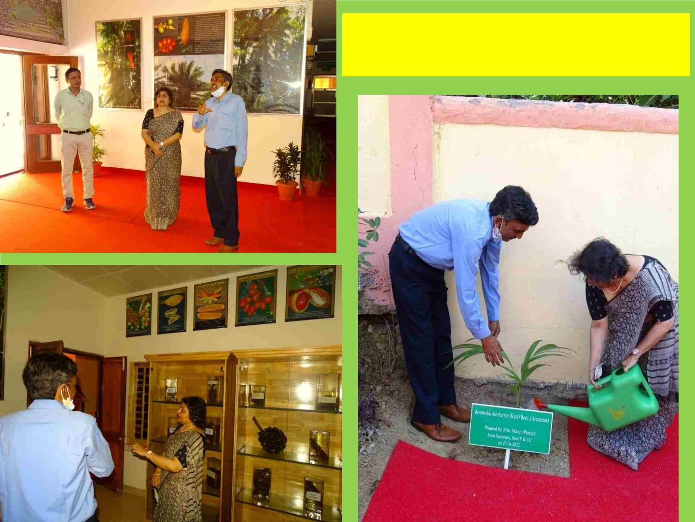
Joint Secretary, MoEF & CC, New
Delhi at BSI, ANRC

Slide 34
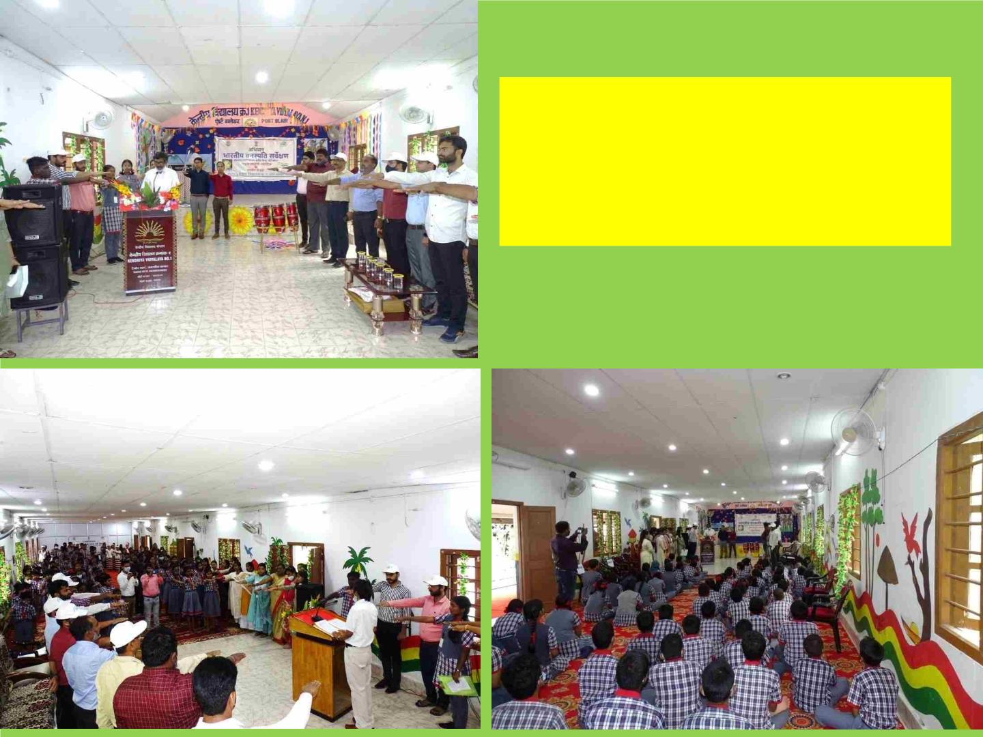
Campaign to avoid the use of
single use plastic & Swachh
Bharat Harit Bharat Green
Pledge organized by BSI, ANRC.

Slide 35
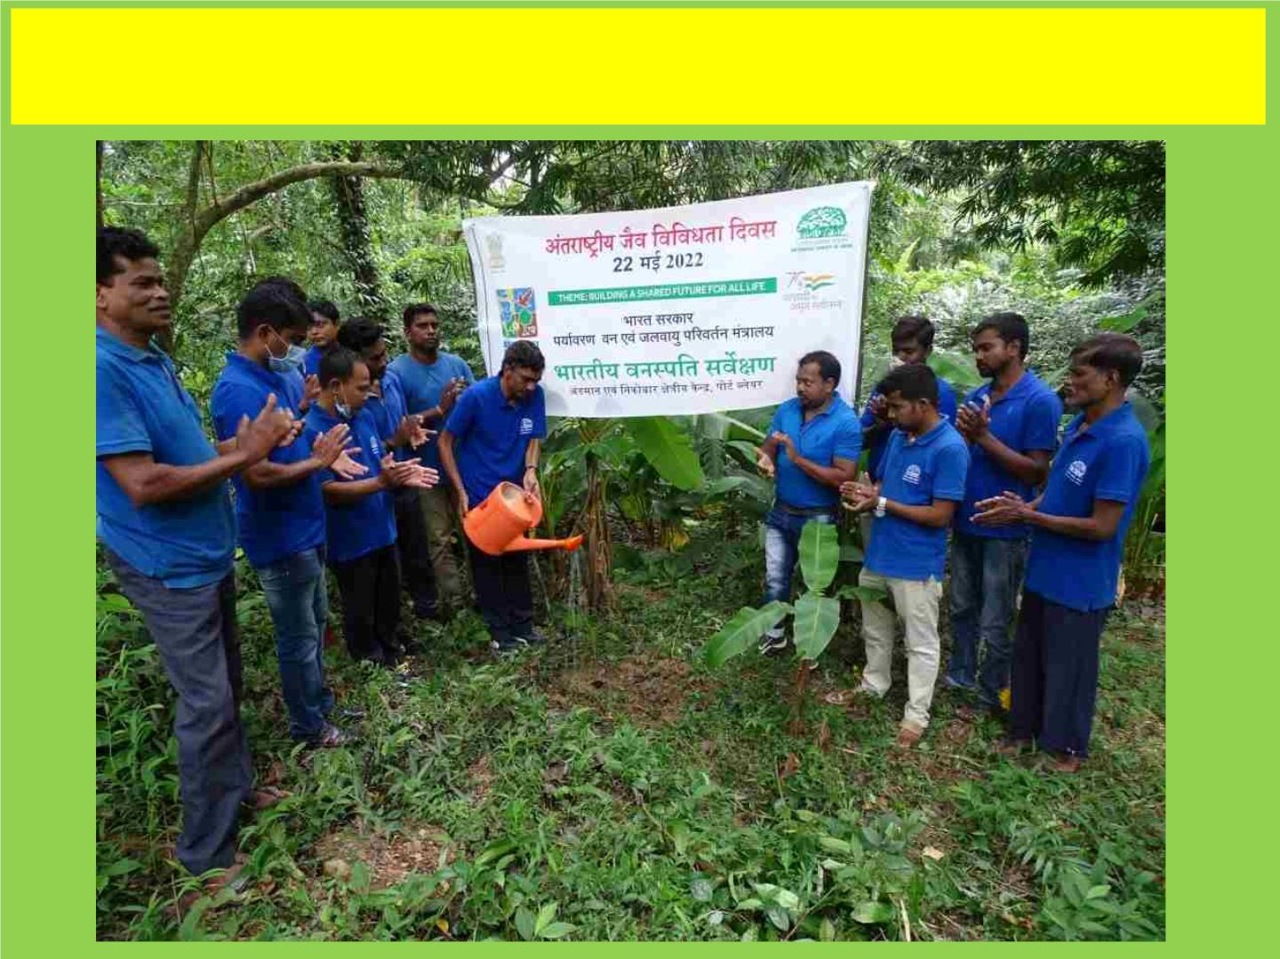
Organized mass tree plantation on the occasion of International Day
for Biological Diversity-2022 by BSI, ANRC.

Slide 36
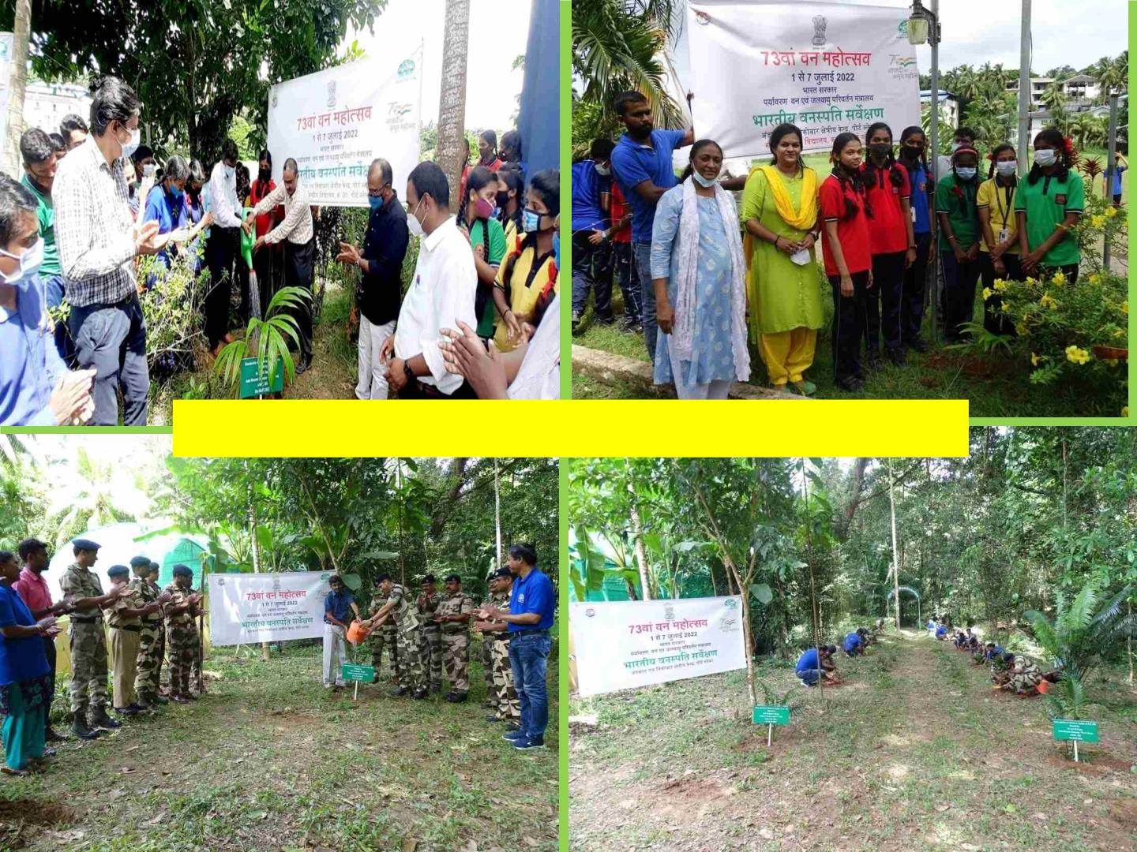
73rd Van Mahatsav-2022 organised by BSI, ANRC

Slide 37
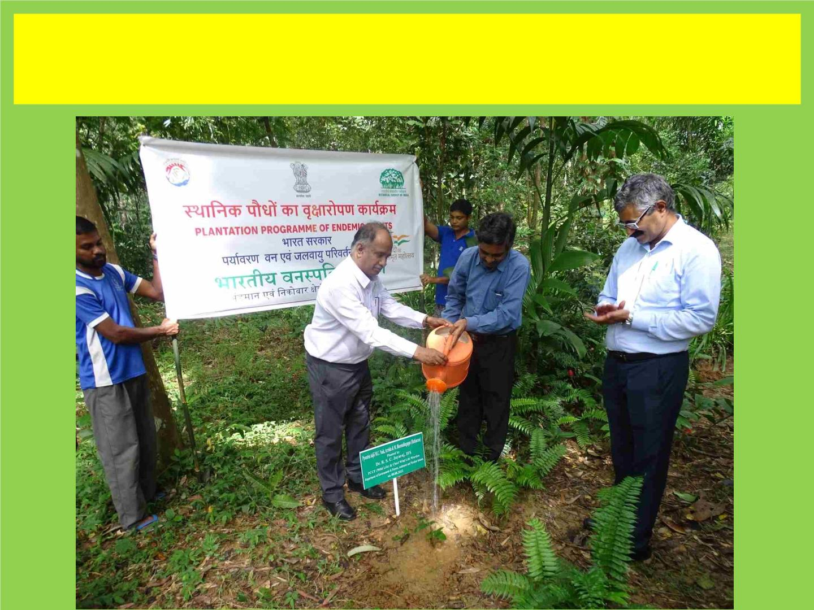
PCCF, Territorial & Wildlife, planted an endemic tree species (Pyrostria laljii
M.C.Naik, Arriola & Bheem.) at BSI Garden as a part of the celebration of ‘Azadi ka
Amrit Mahotsav’.

Slide 38
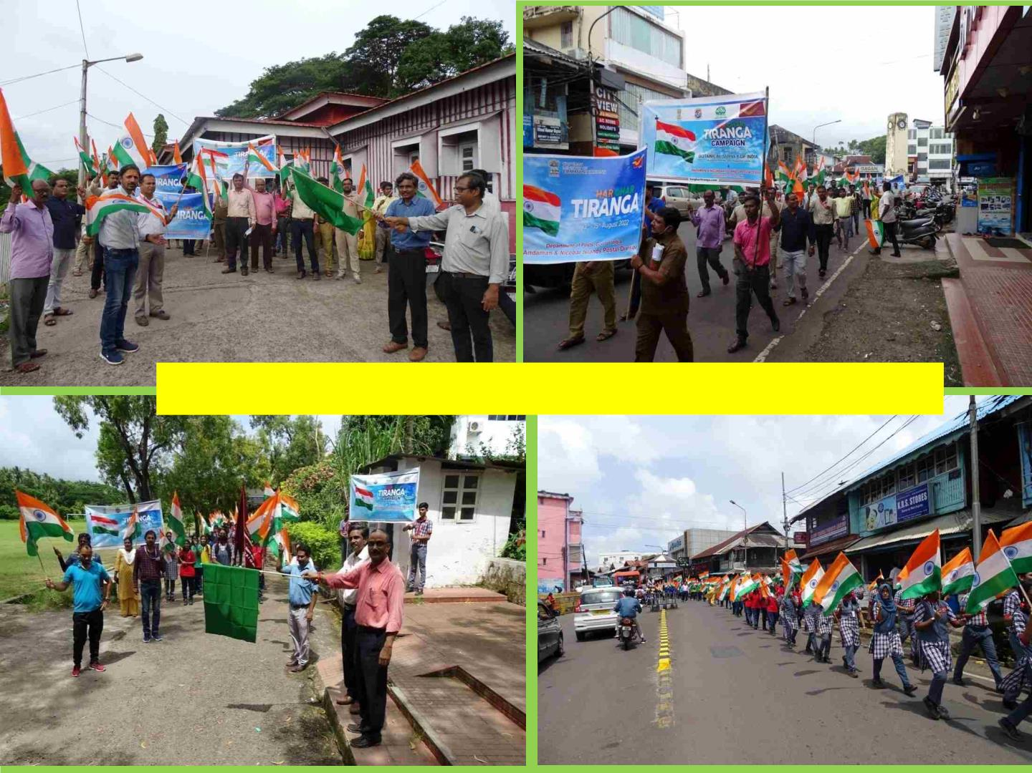
Har Ghar Tiranga Rally-2022 organized by BSI, ANRC

Slide 39
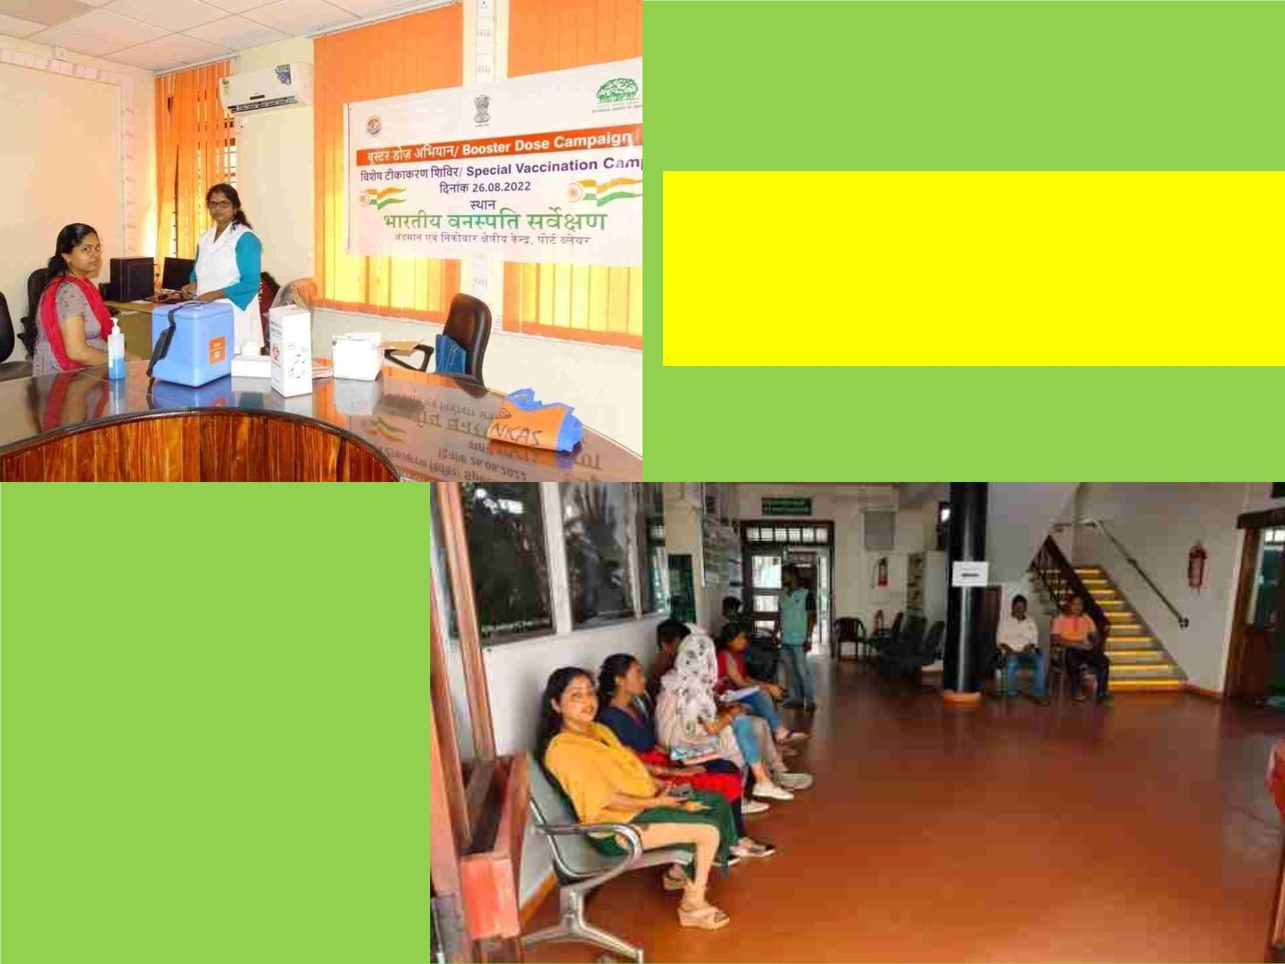
Booster Dose Campaign
Special Vaccination Camp
organised by BSI, ANRC.

Slide 40
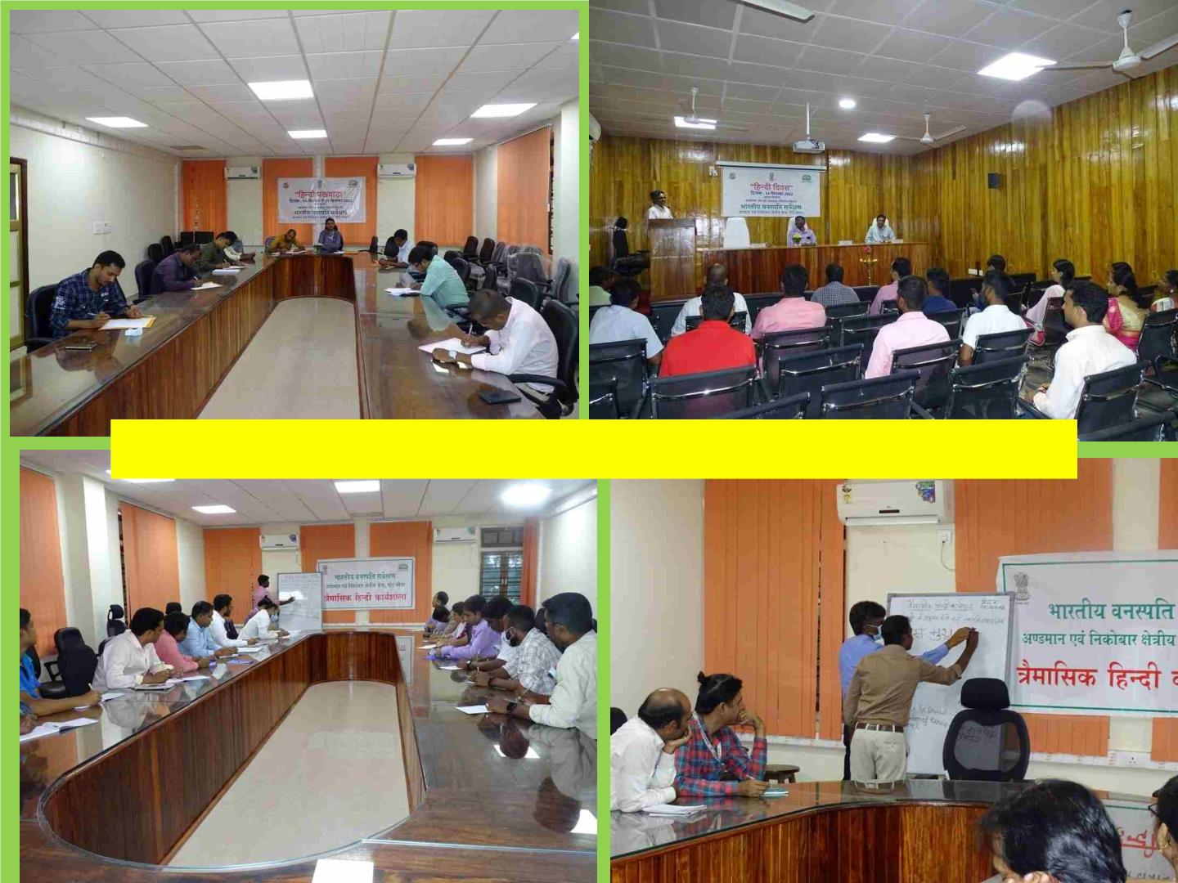
Hindi Pakhwara and Hindi Workshop-2022 at BSI, ANRC.

Slide 41
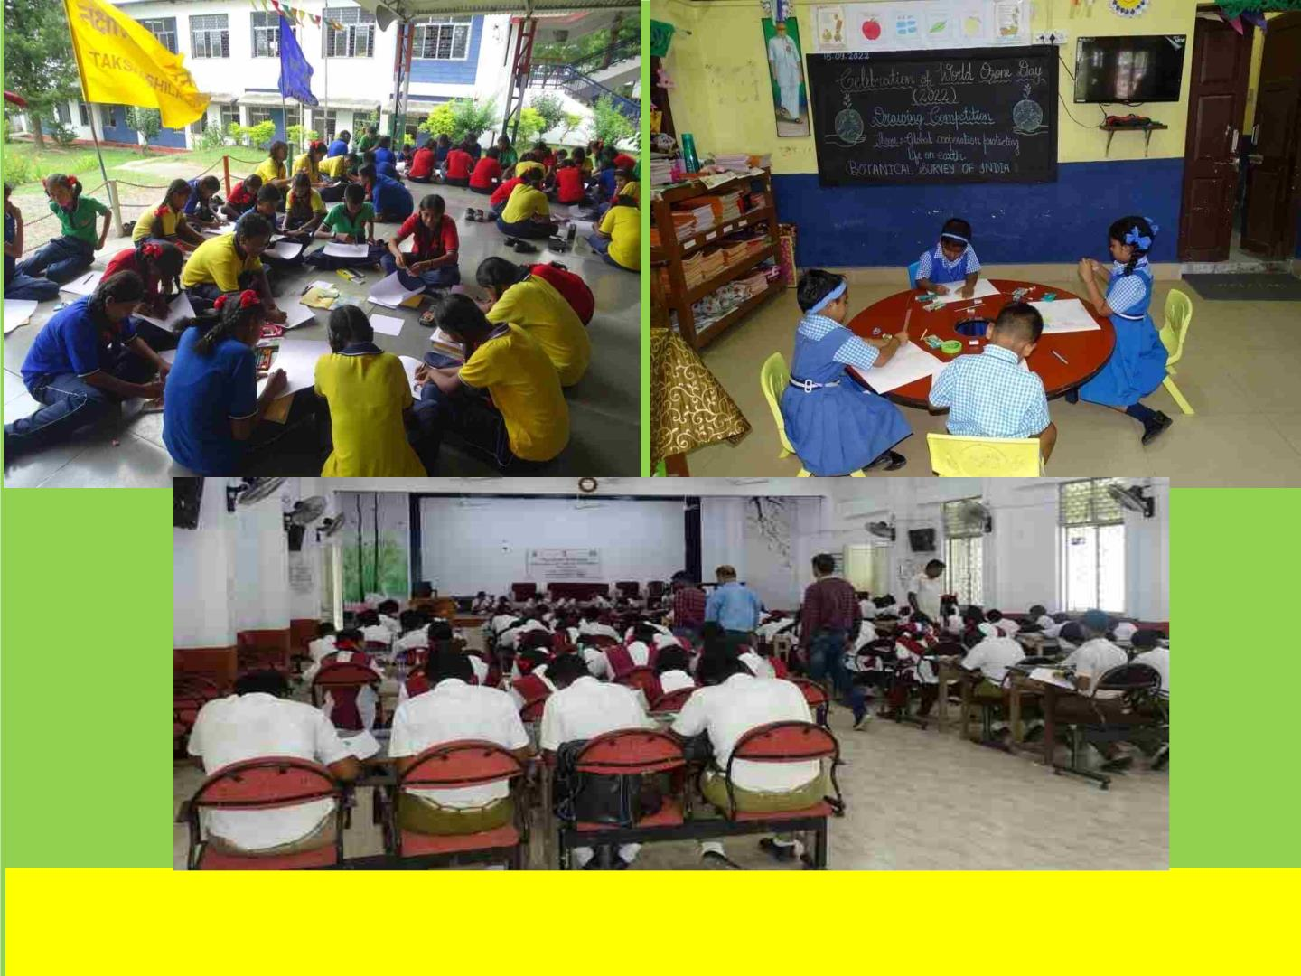
Organized drawing competition for school children on the occasion of
World Ozone Day-2022 by BSI, ANRC.

Slide 42
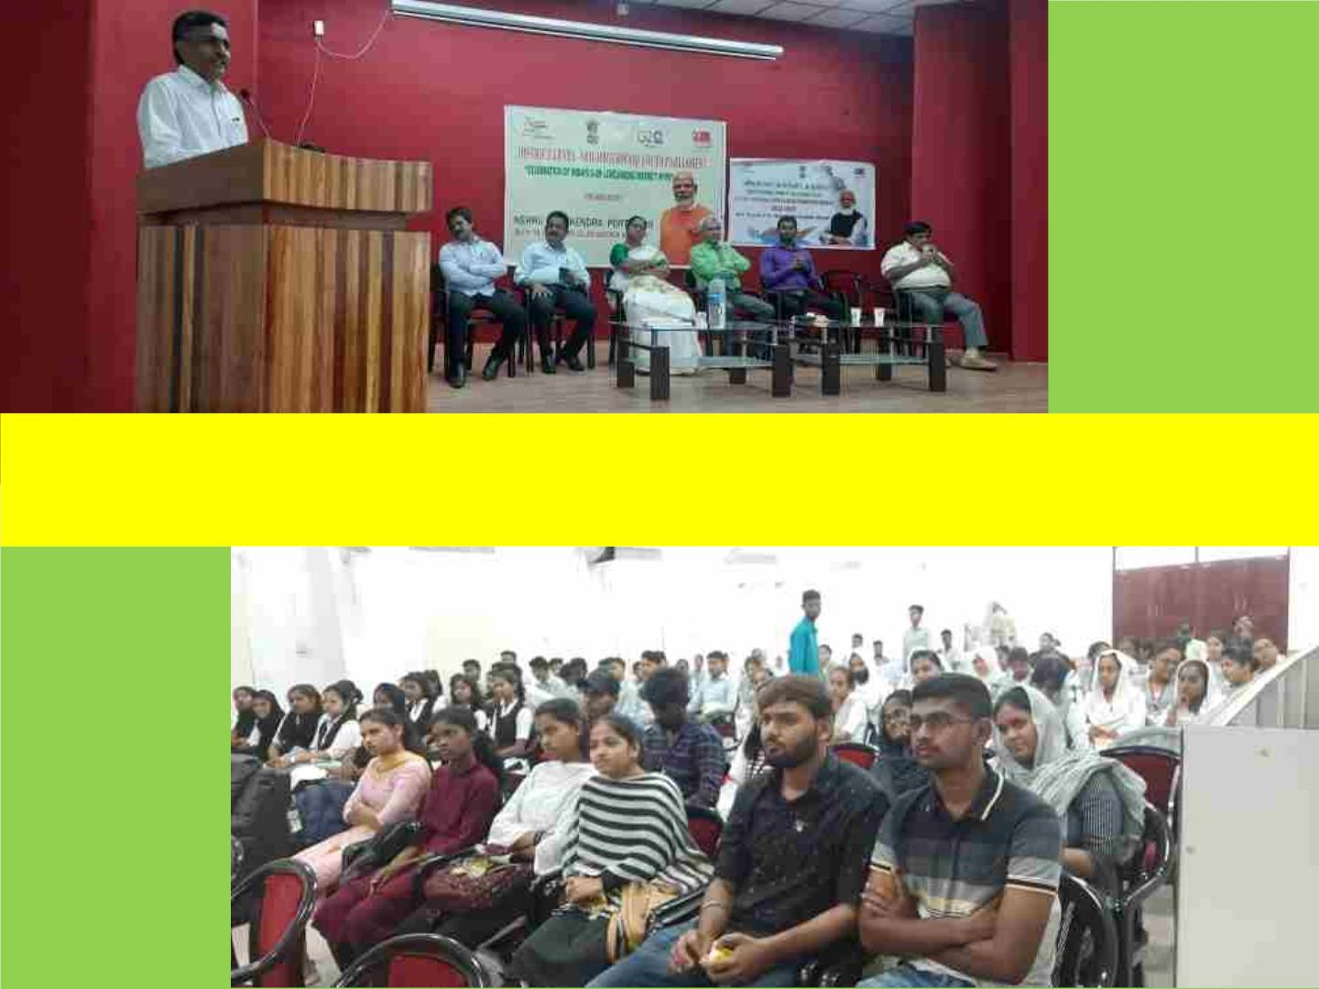
Special invited lecture on ‘Mission LIFE’ delivered by Dr. Lal Ji Singh, Scientist-E & HoO, during
seminar in District Level Neighbourhood Youth Parliament organised by Nehru Yuva Kendra,
Port Blair.

Slide 43
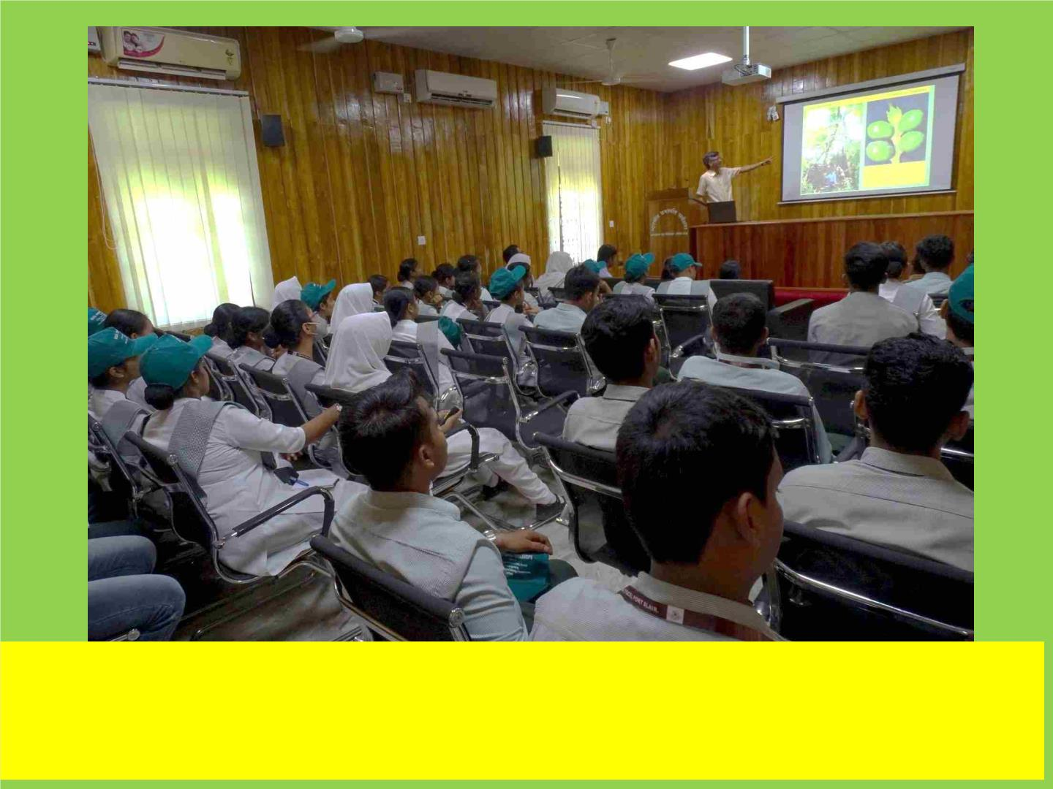
Organized a special lecture for teacher trainees by BSI, ANRC:
Dr. Lal Ji Singh, Scientist-E & HoO delivered a lecture on “Plant Diversity
of Andaman and Nicobar Islands-An overview”.

Slide 44
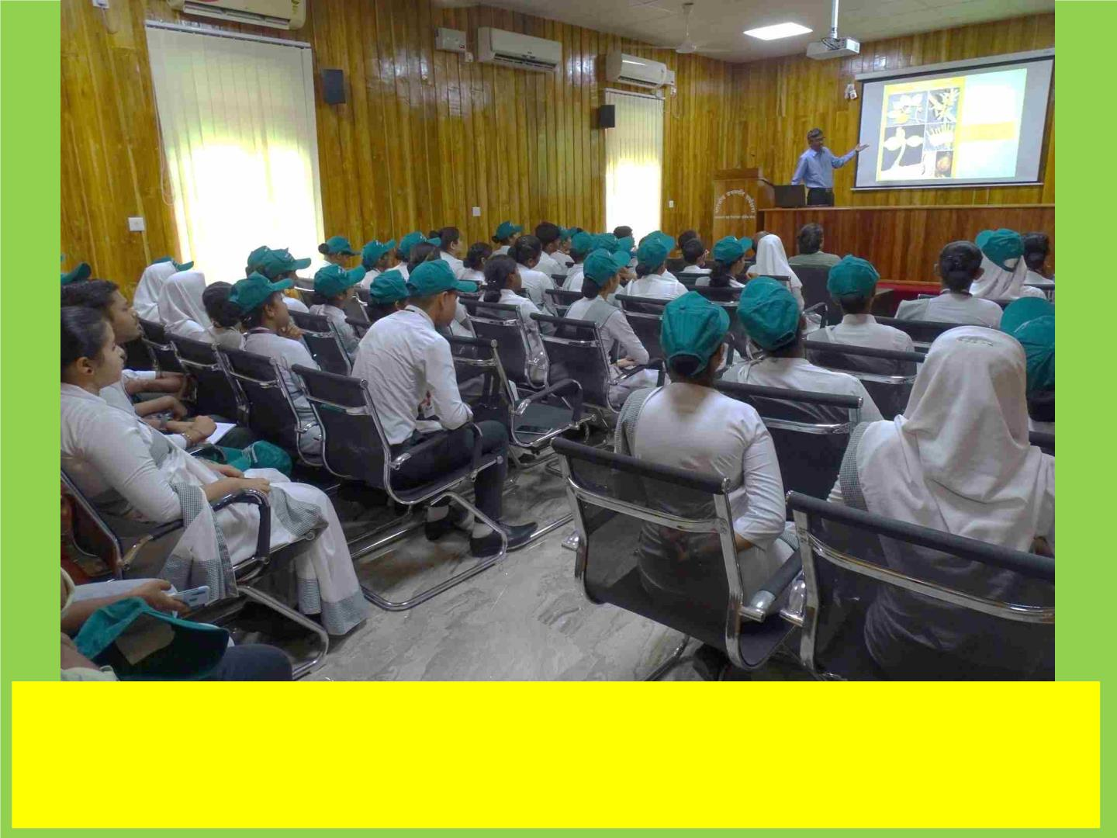
Organized a special lecture for teacher trainees by BSI, ANRC:
Dr. Lal Ji Singh, Scientist-E & HoO delivered a lecture on “Endemic
Flora of Andaman and Nicobar Islands and its conservation”

Slide 45
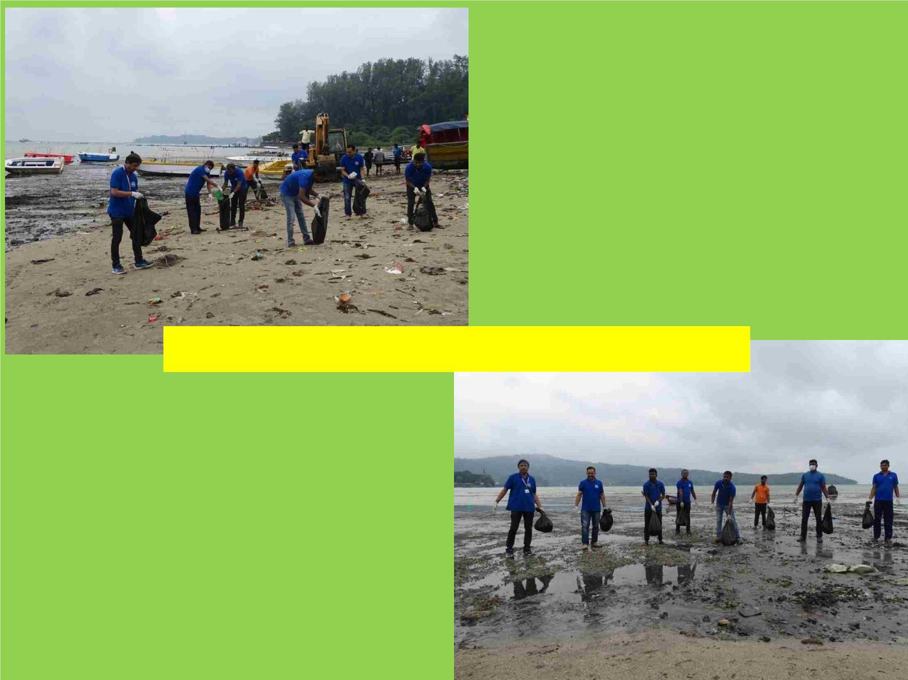
Beach Cleaning Drive organised by BSI, ANRC

Slide 46
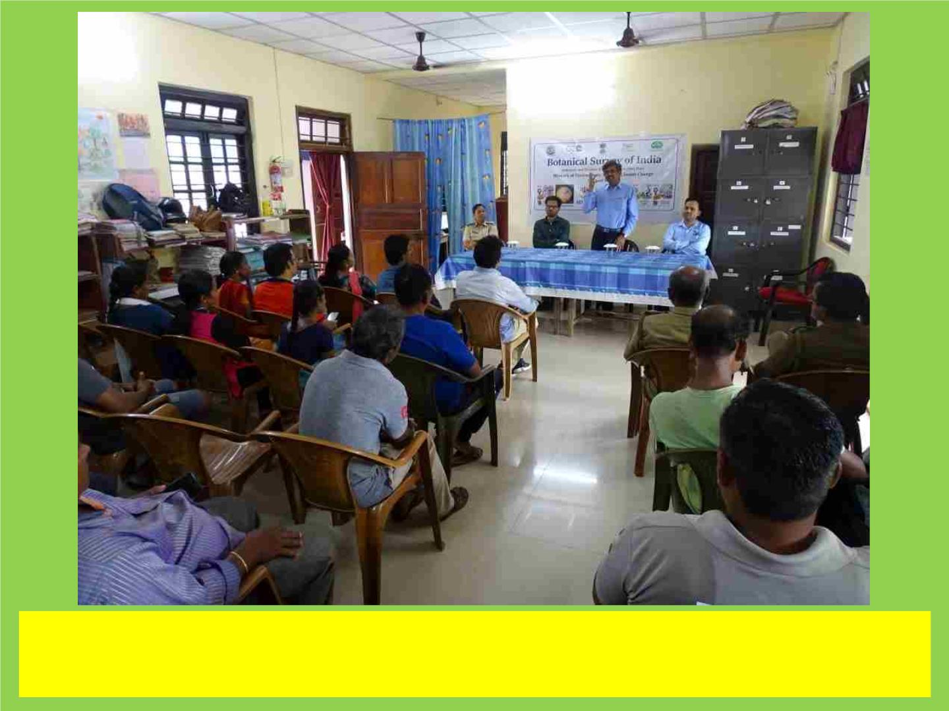
Organized a special lecture for Officers and staff of forest by BSI,
ANRC as a part of MISSION LiFE.

Slide 47
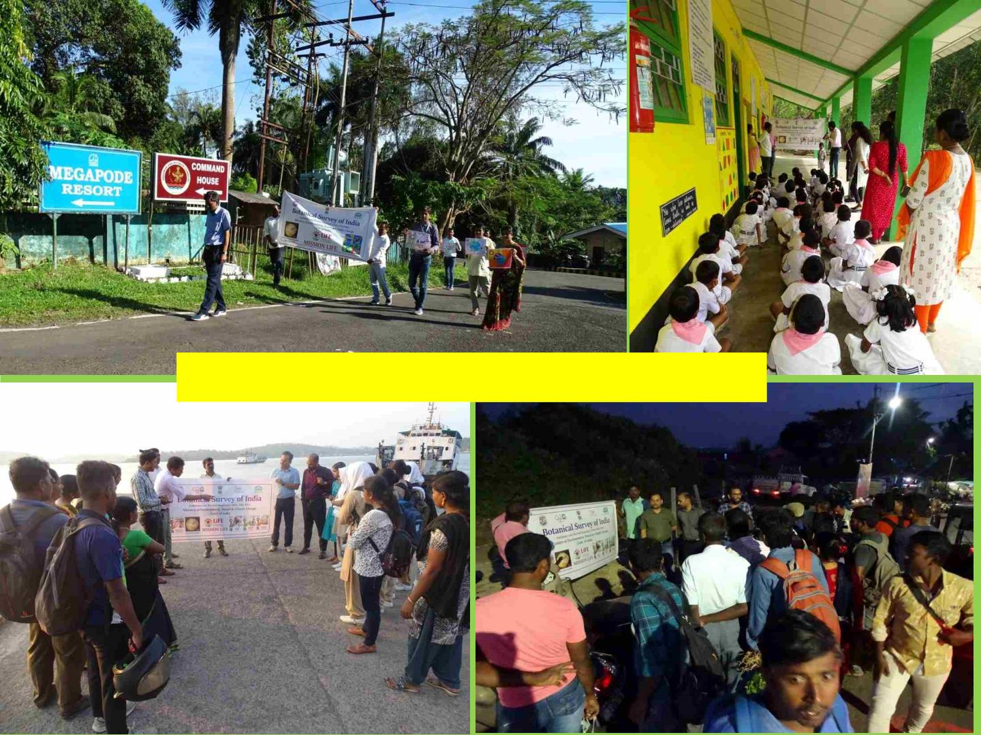
Mission LiFE-2022 organised by BSI, ANRC

Slide 48
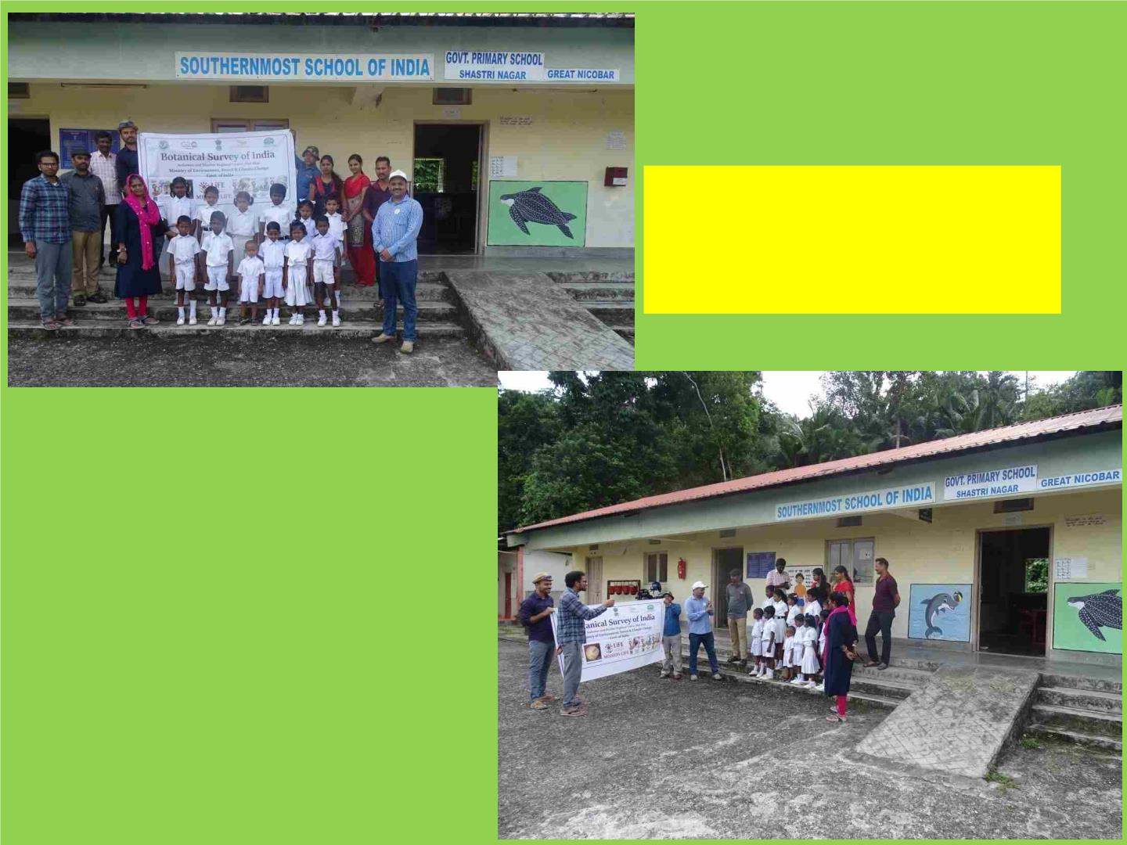
Mission LiFE reaches to
the Southernmost School
of India

Slide 49
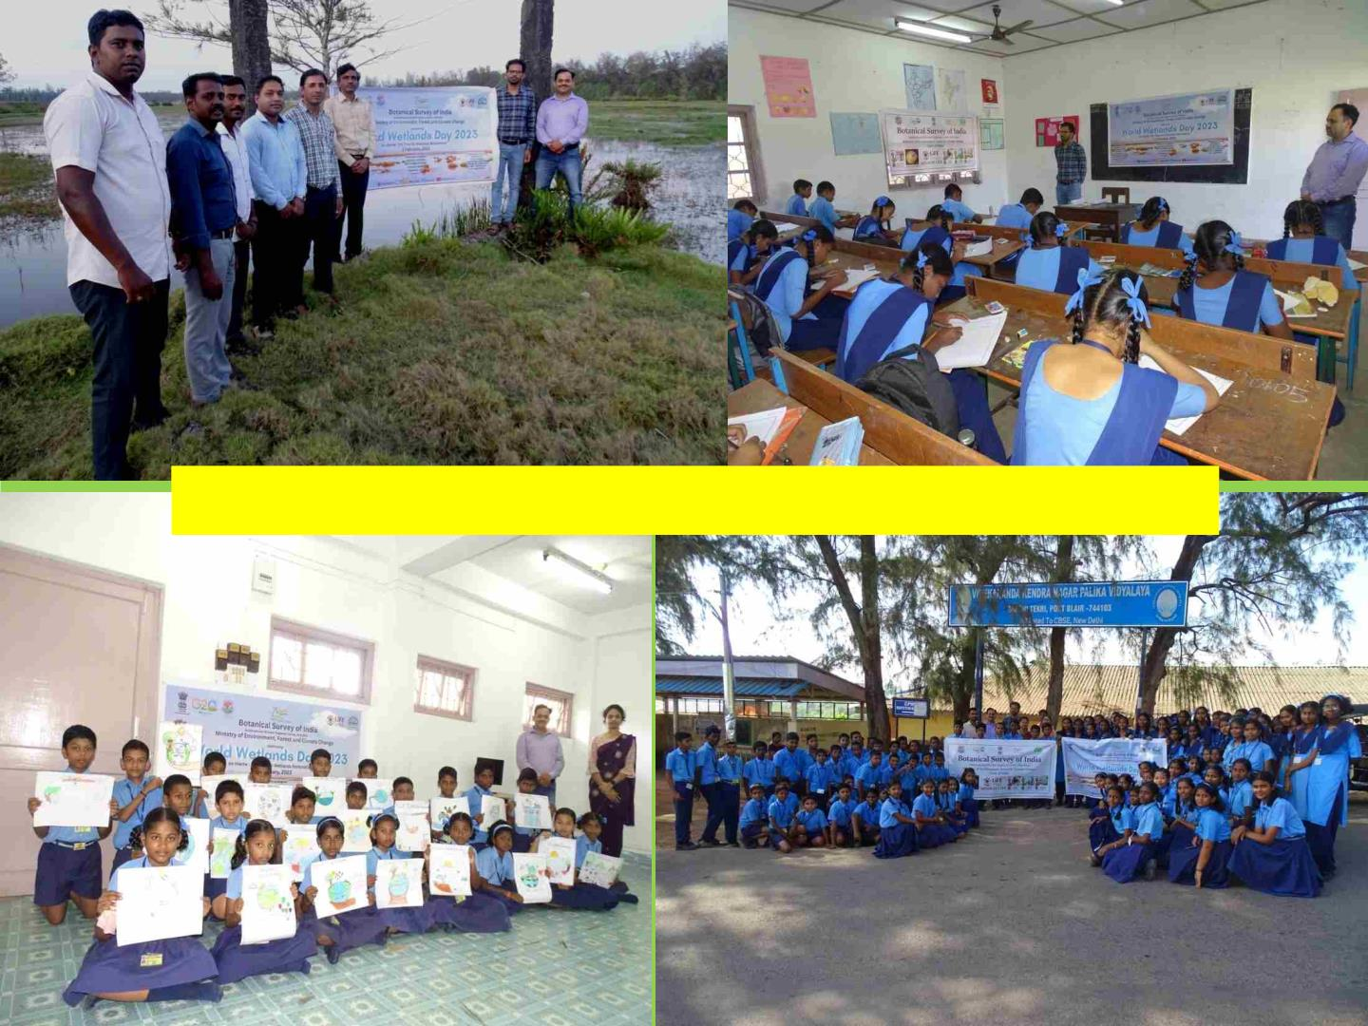
World Wetlands Day-2023 organised by BSI, ANRC.

Slide 50
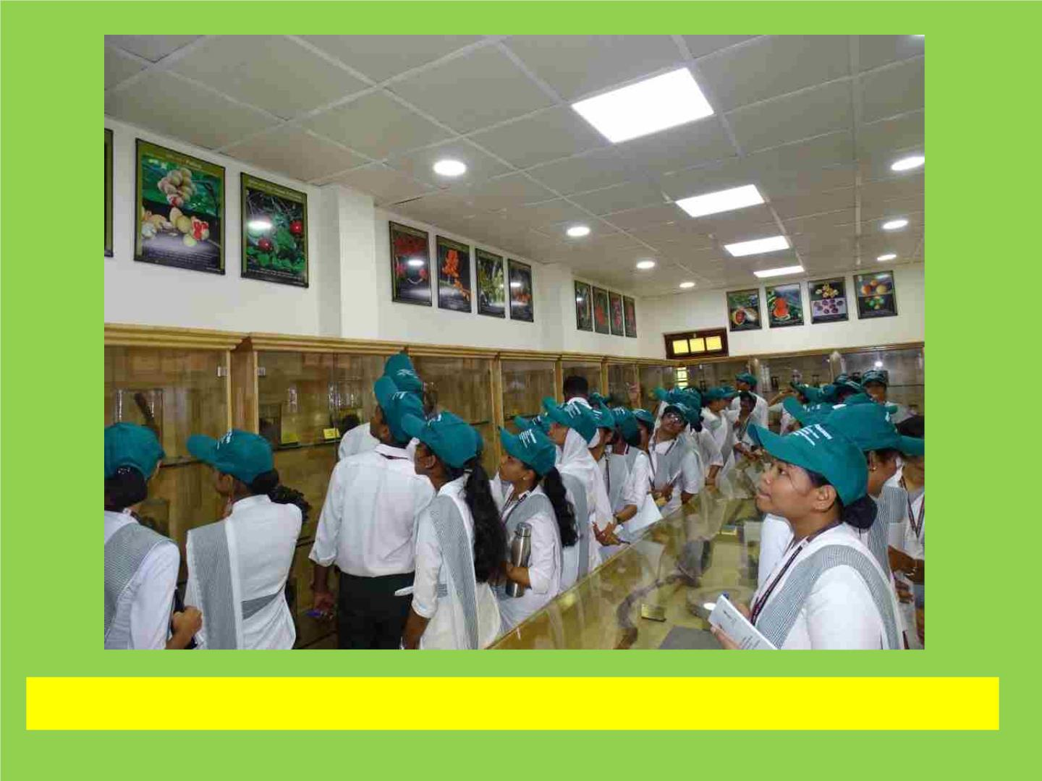
Teacher trainees of TGCE College Students at Museum, BSI, ANRC

Slide 51
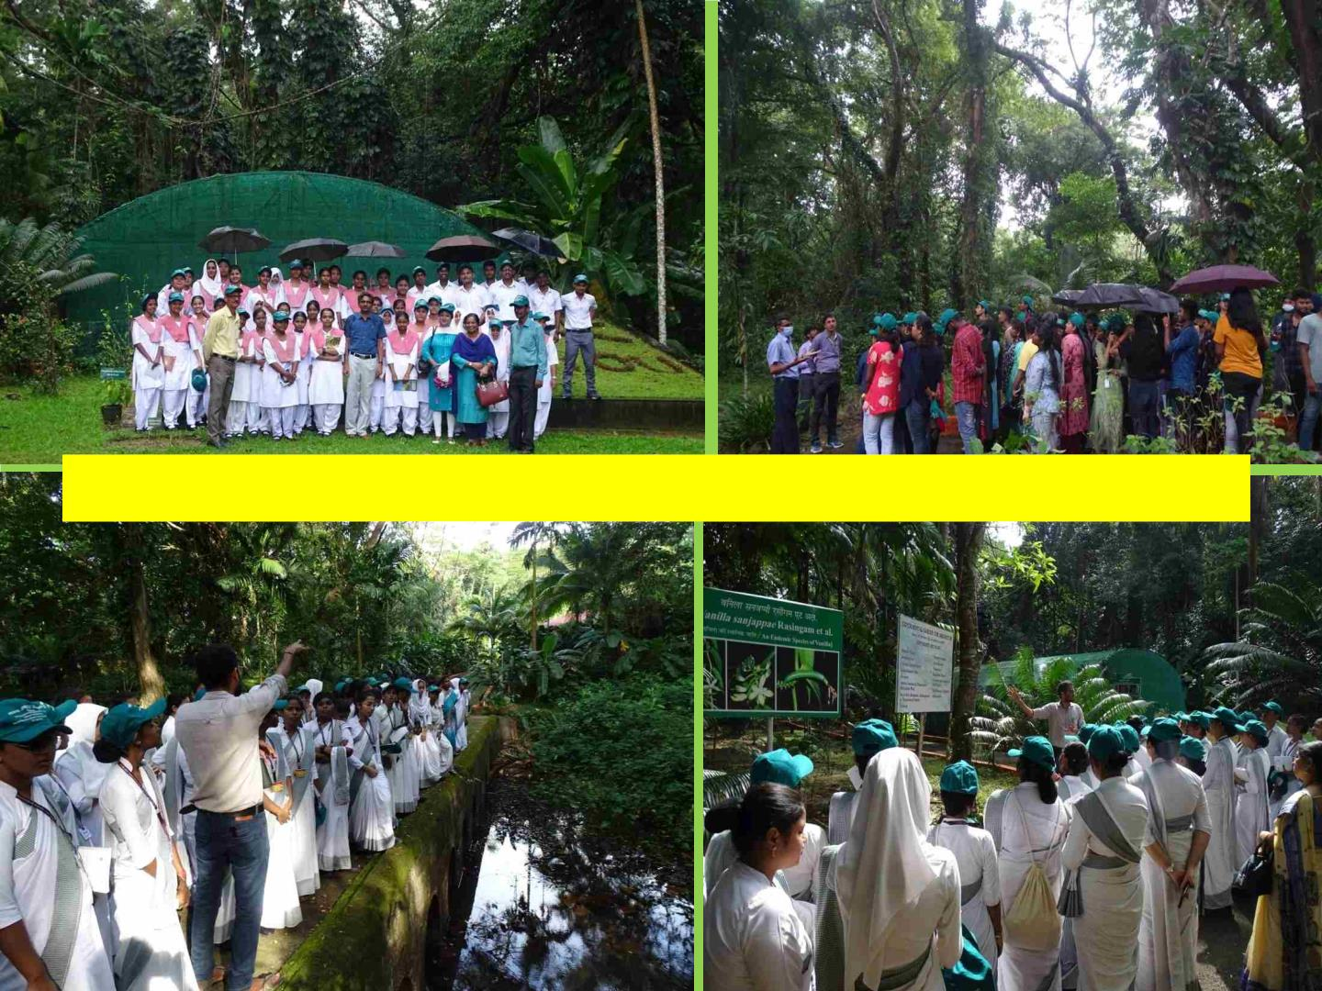
Teacher trainees and students visited at Garden, BSI, ANRC.

Slide 52
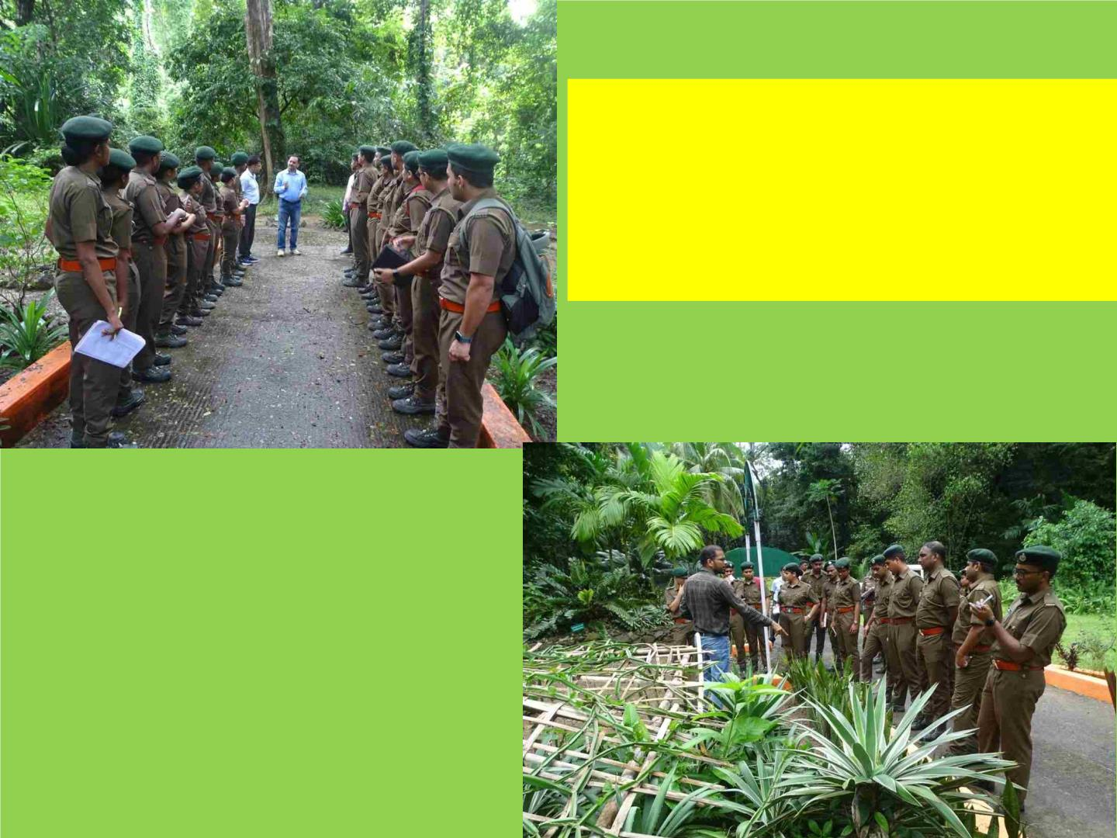
51st Batch of Forester Course
Trainees, Forest Training
Institute, Wimberlygunj,
South Andaman.

Slide 53
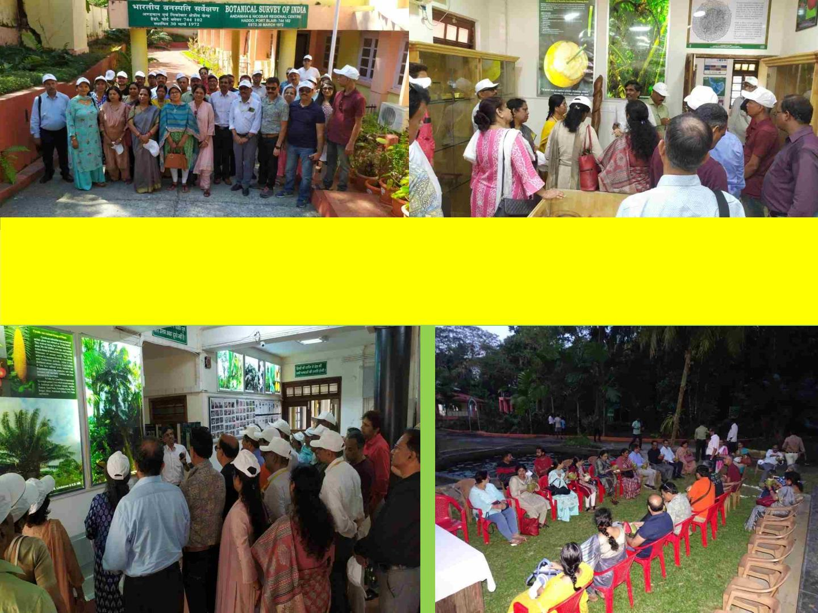
08th Level V trainees (PSOs/ Sr. PPS of CSSS) of Government of India
visited at BSI-ANRC during Mid-career Training Course coordinated by
DoPT, Govt. of India.

Slide 54
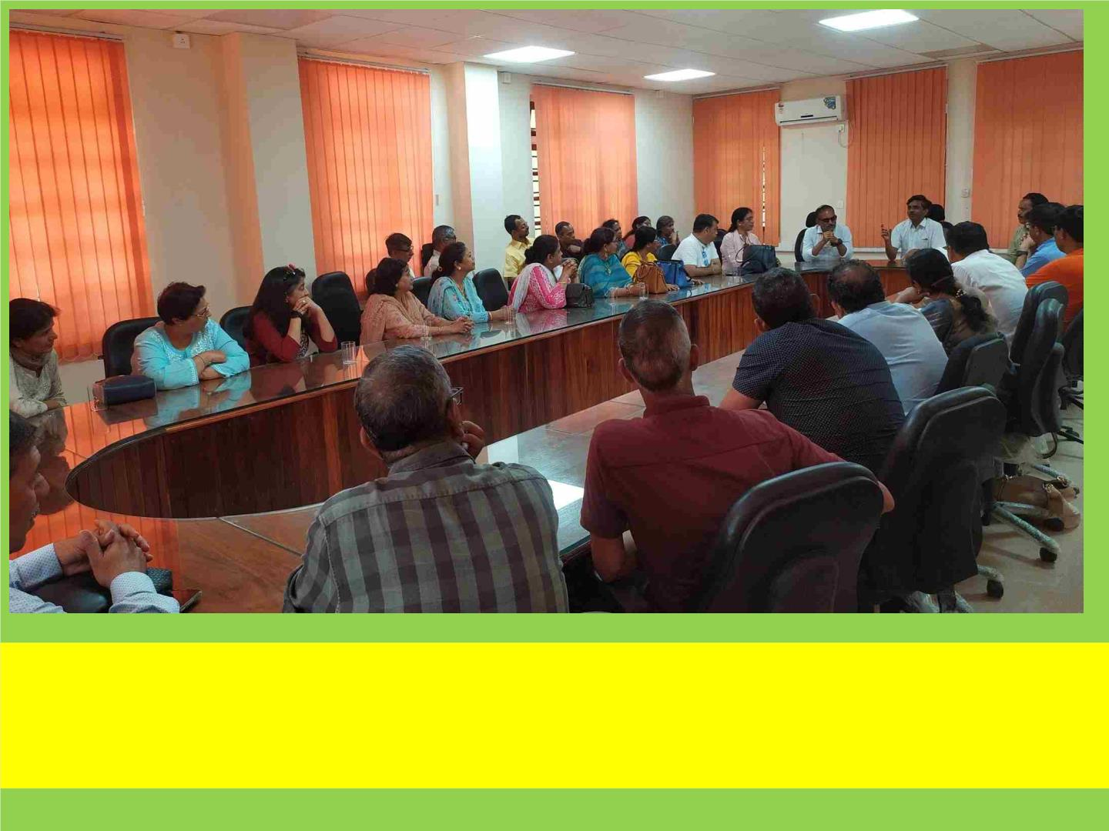
Dr. Lal Ji Singh, Scientist-E & HoO interacting with 08th Level V trainees
(PSOs/ Sr. PPS of CSSS) of Government of India during their visit at BSI-
ANRC.

Slide 55


